Slide 1
3D Ponics

Slide 2
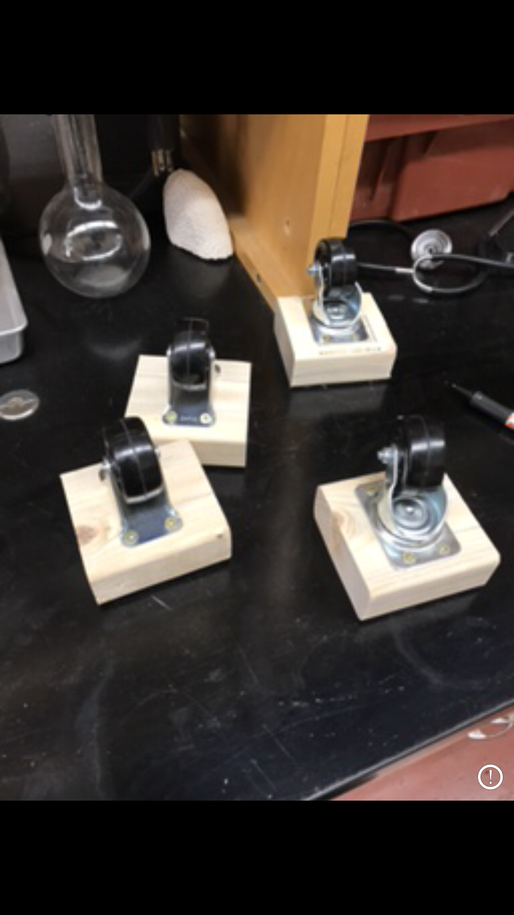
The main idea
Get the carts on wheels.
Drill out holes on tubes(channels) & have water drip down a tube to the next channel.
Hook up a pump and get water flowing threw all systems consistently.

Slide 3
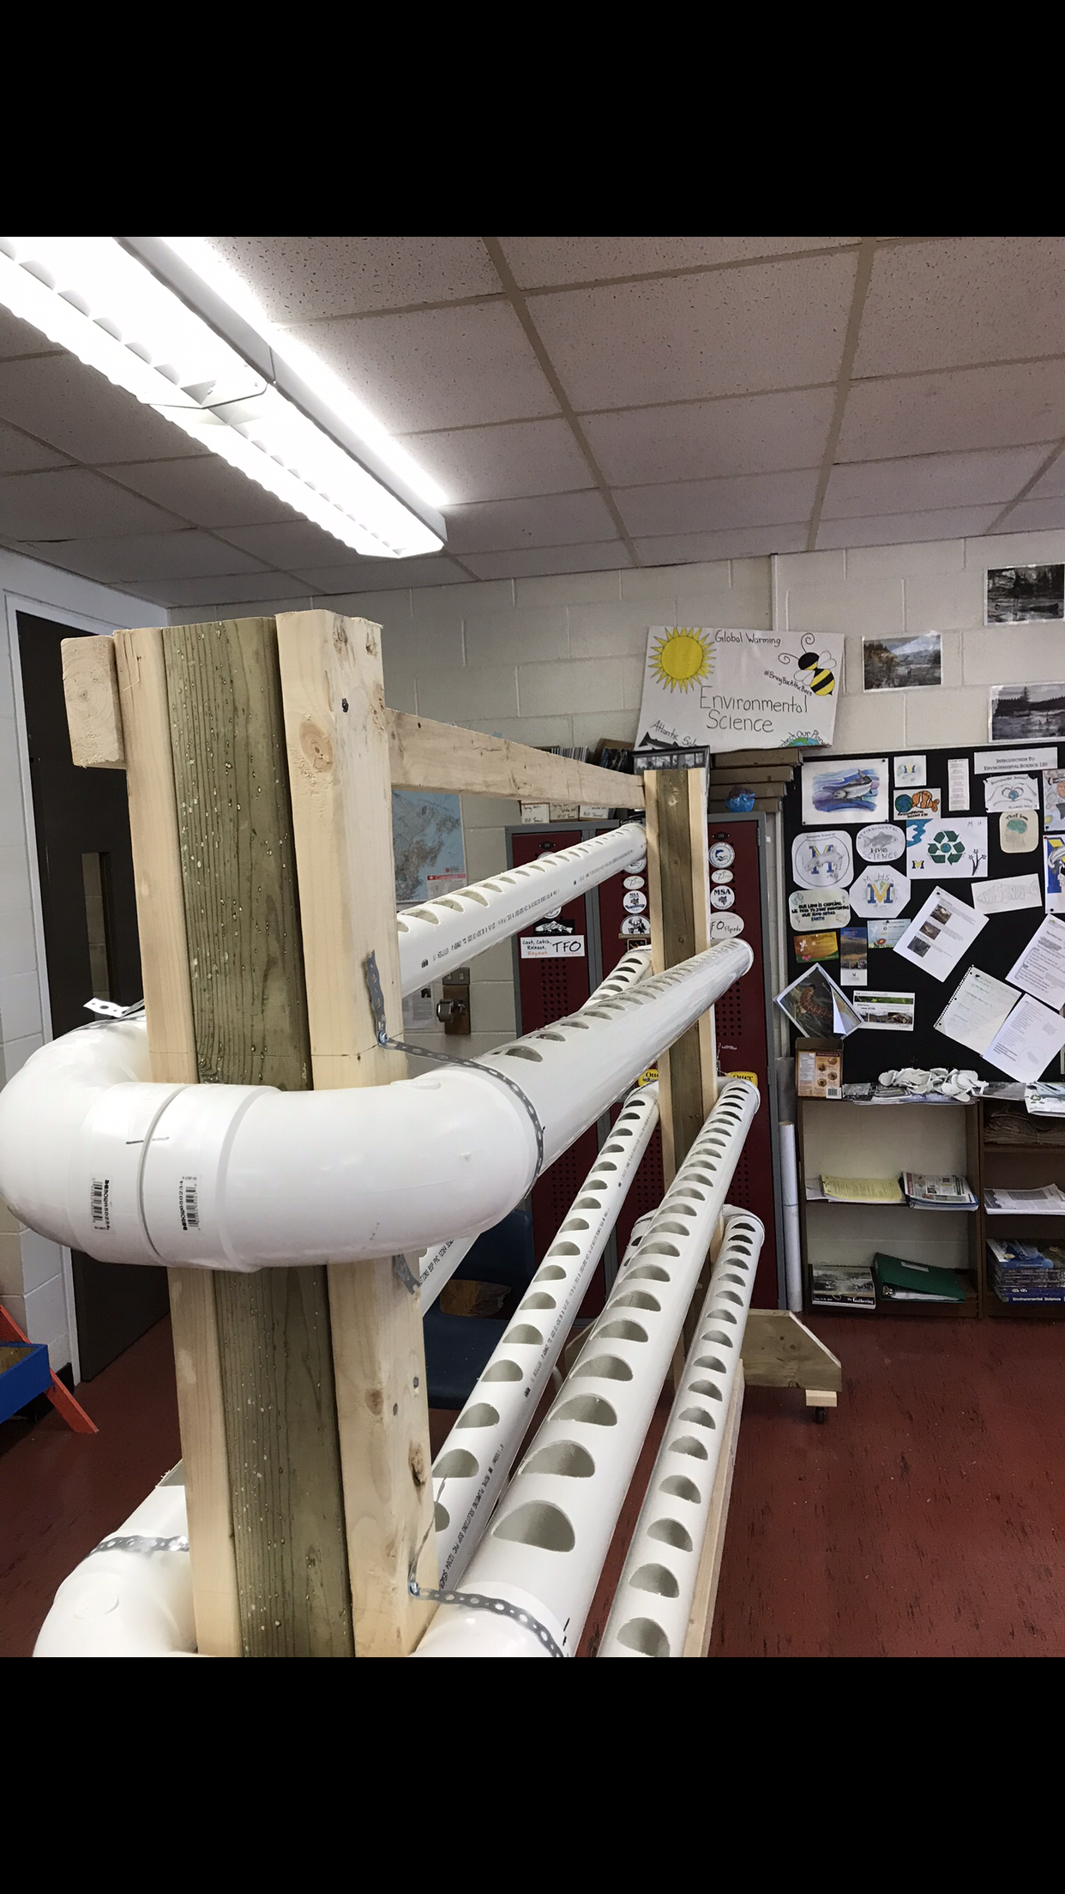
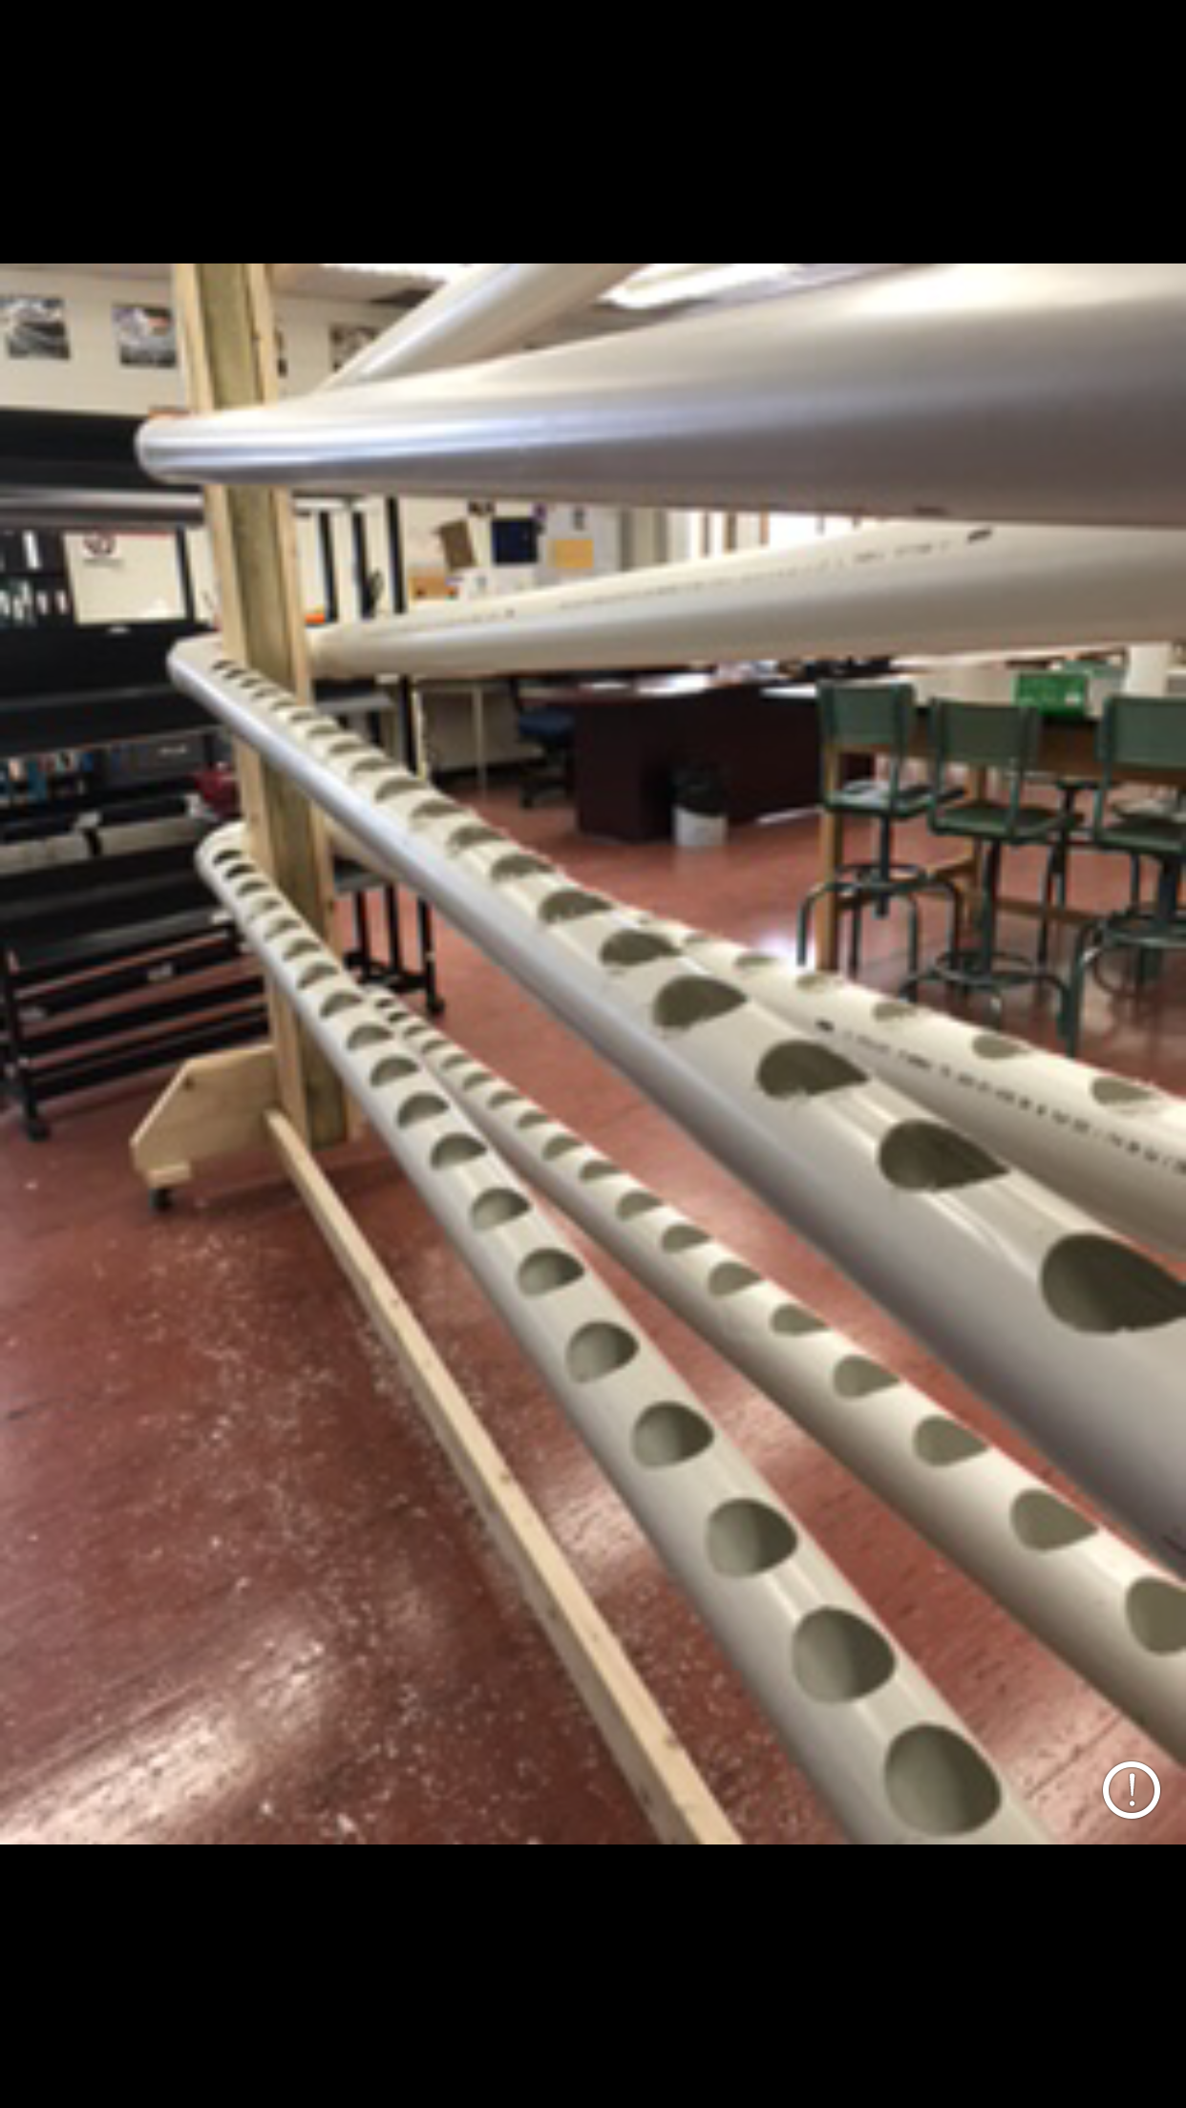
System 1(tubular channels)

Slide 4
System 2(drip channel)

Slide 5
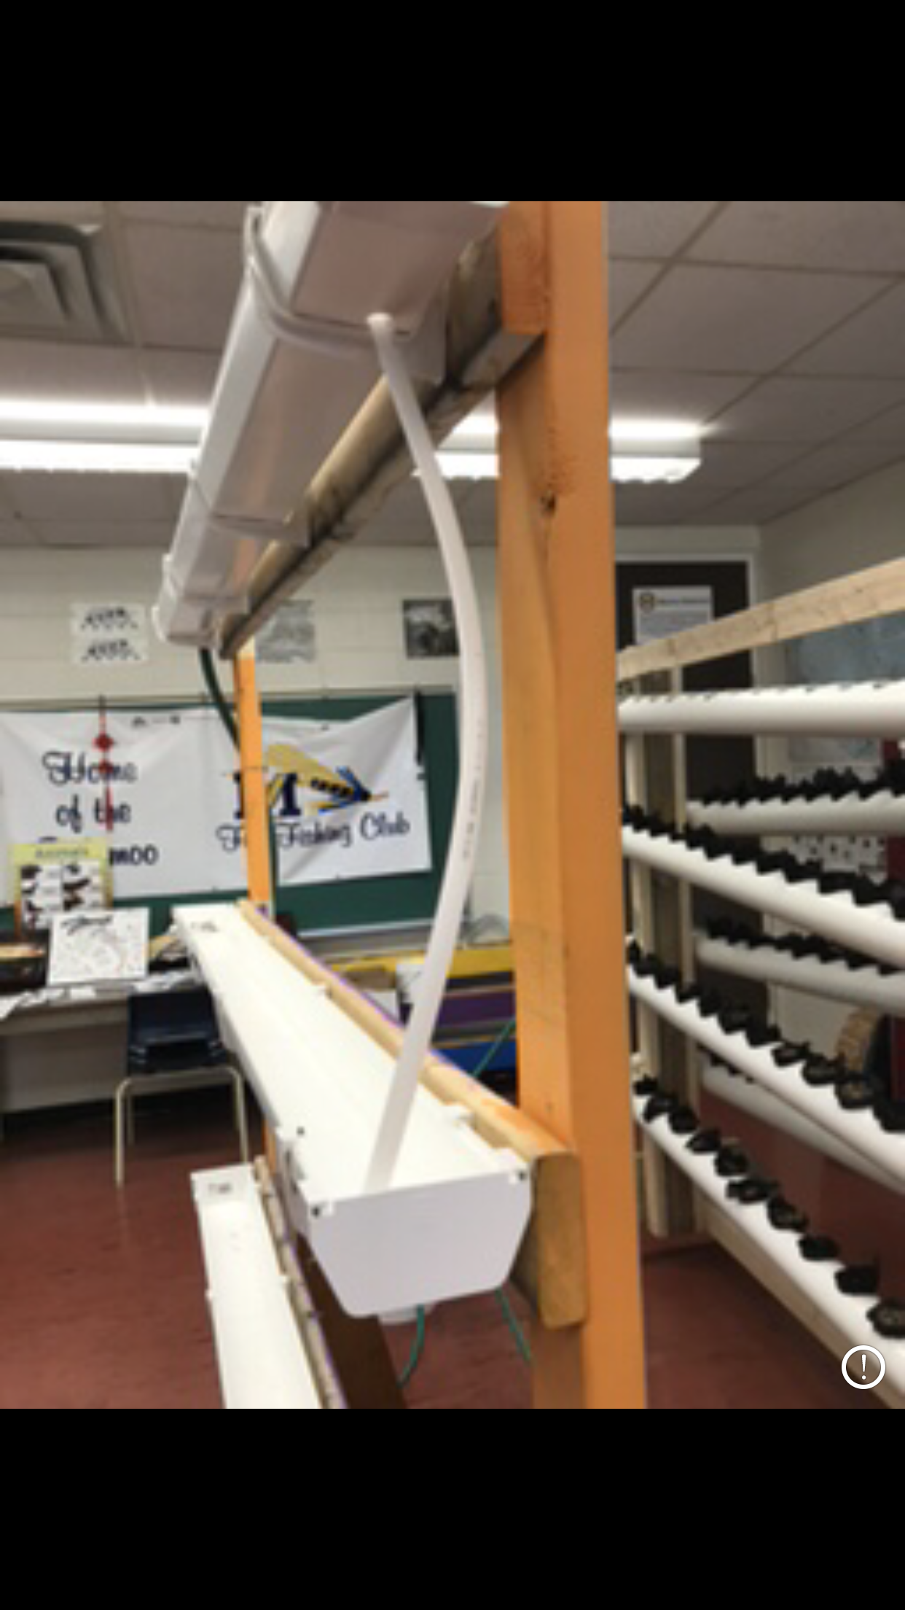
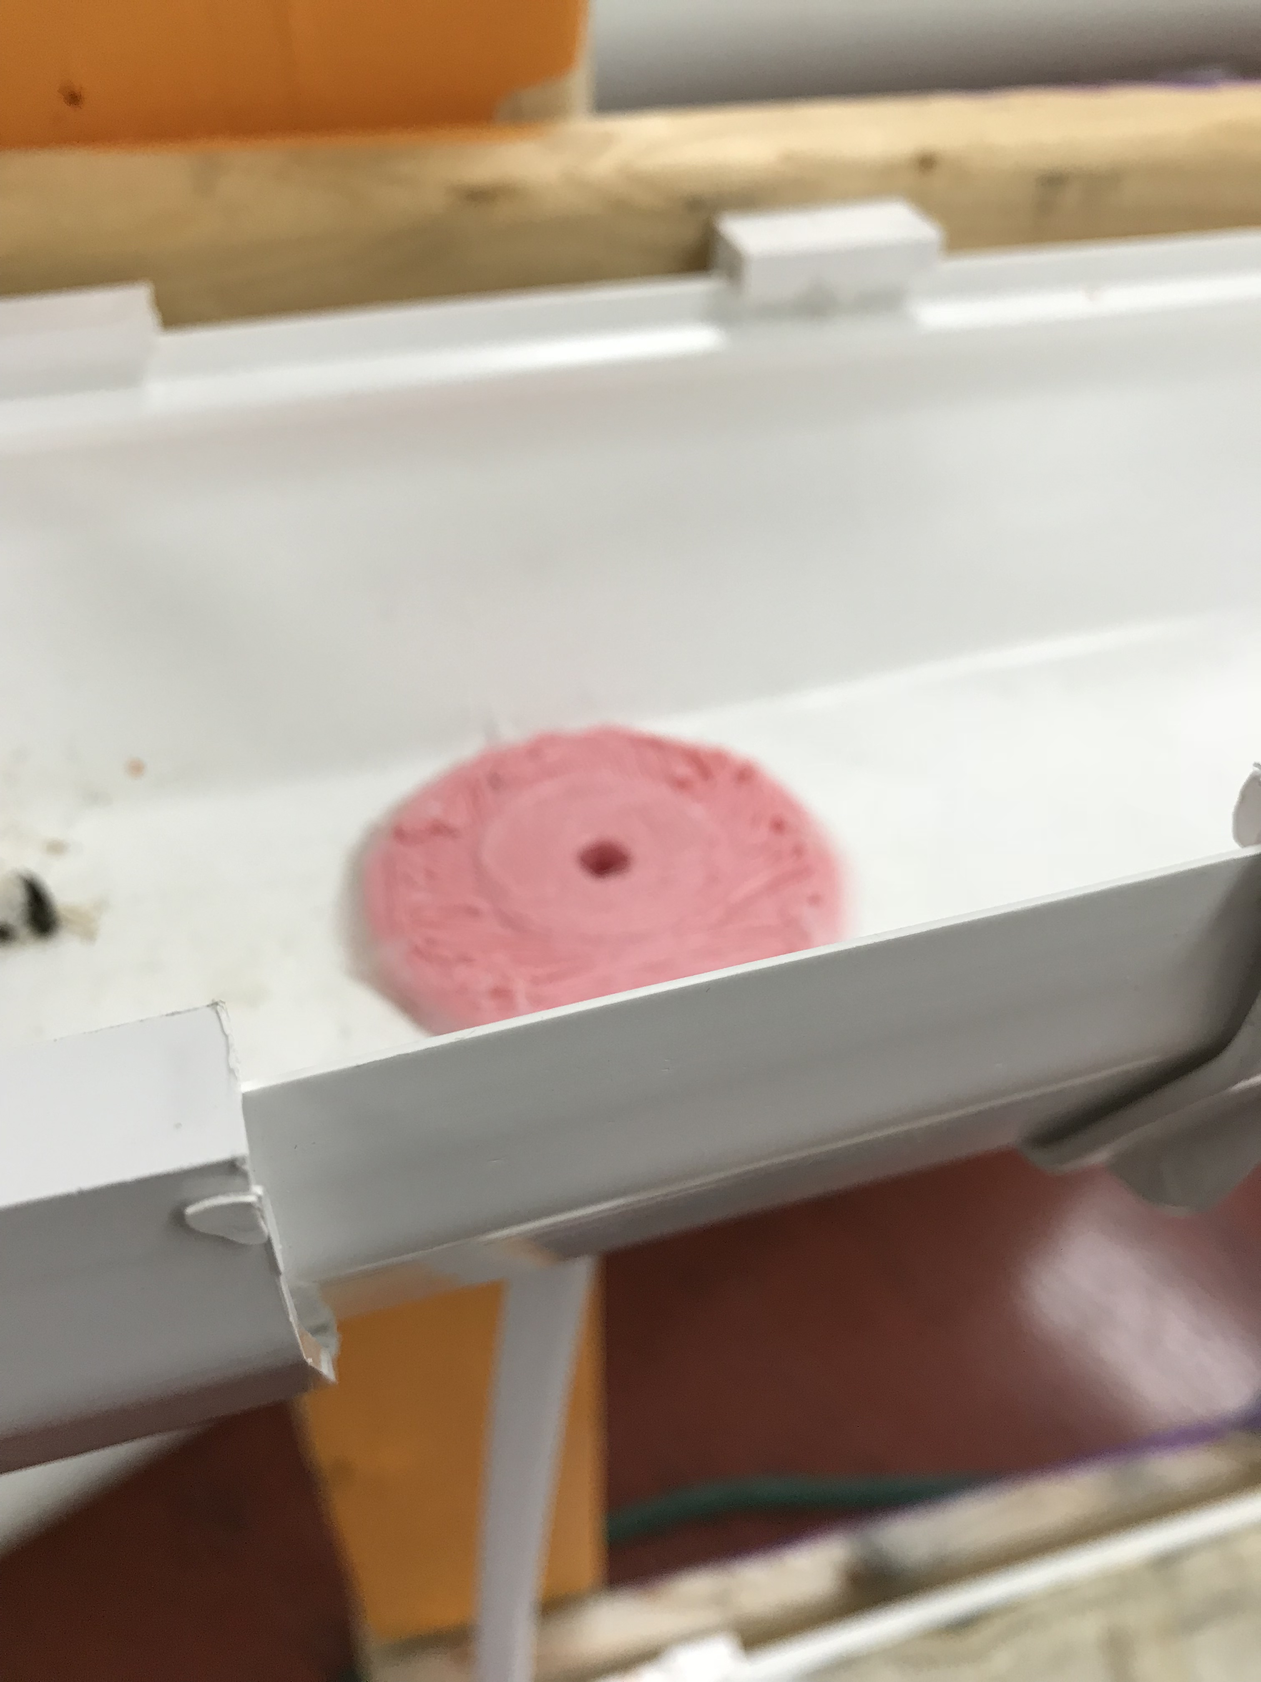
Custom 3d part
This was made to flow water from one channel to another without splash.

Slide 6
Problems
Water dripping then splashing up all over
Water flowage
Pump “s”.(not enough power to flow good)
Nothing to hold water coming in and out.

Slide 7
Solutions
Made 3d part to stop dripping and splashing
Cut up an old hose and hooked them up to the systems
Got a submersible pump
Got two water drums for water flowing in and out

Slide 8
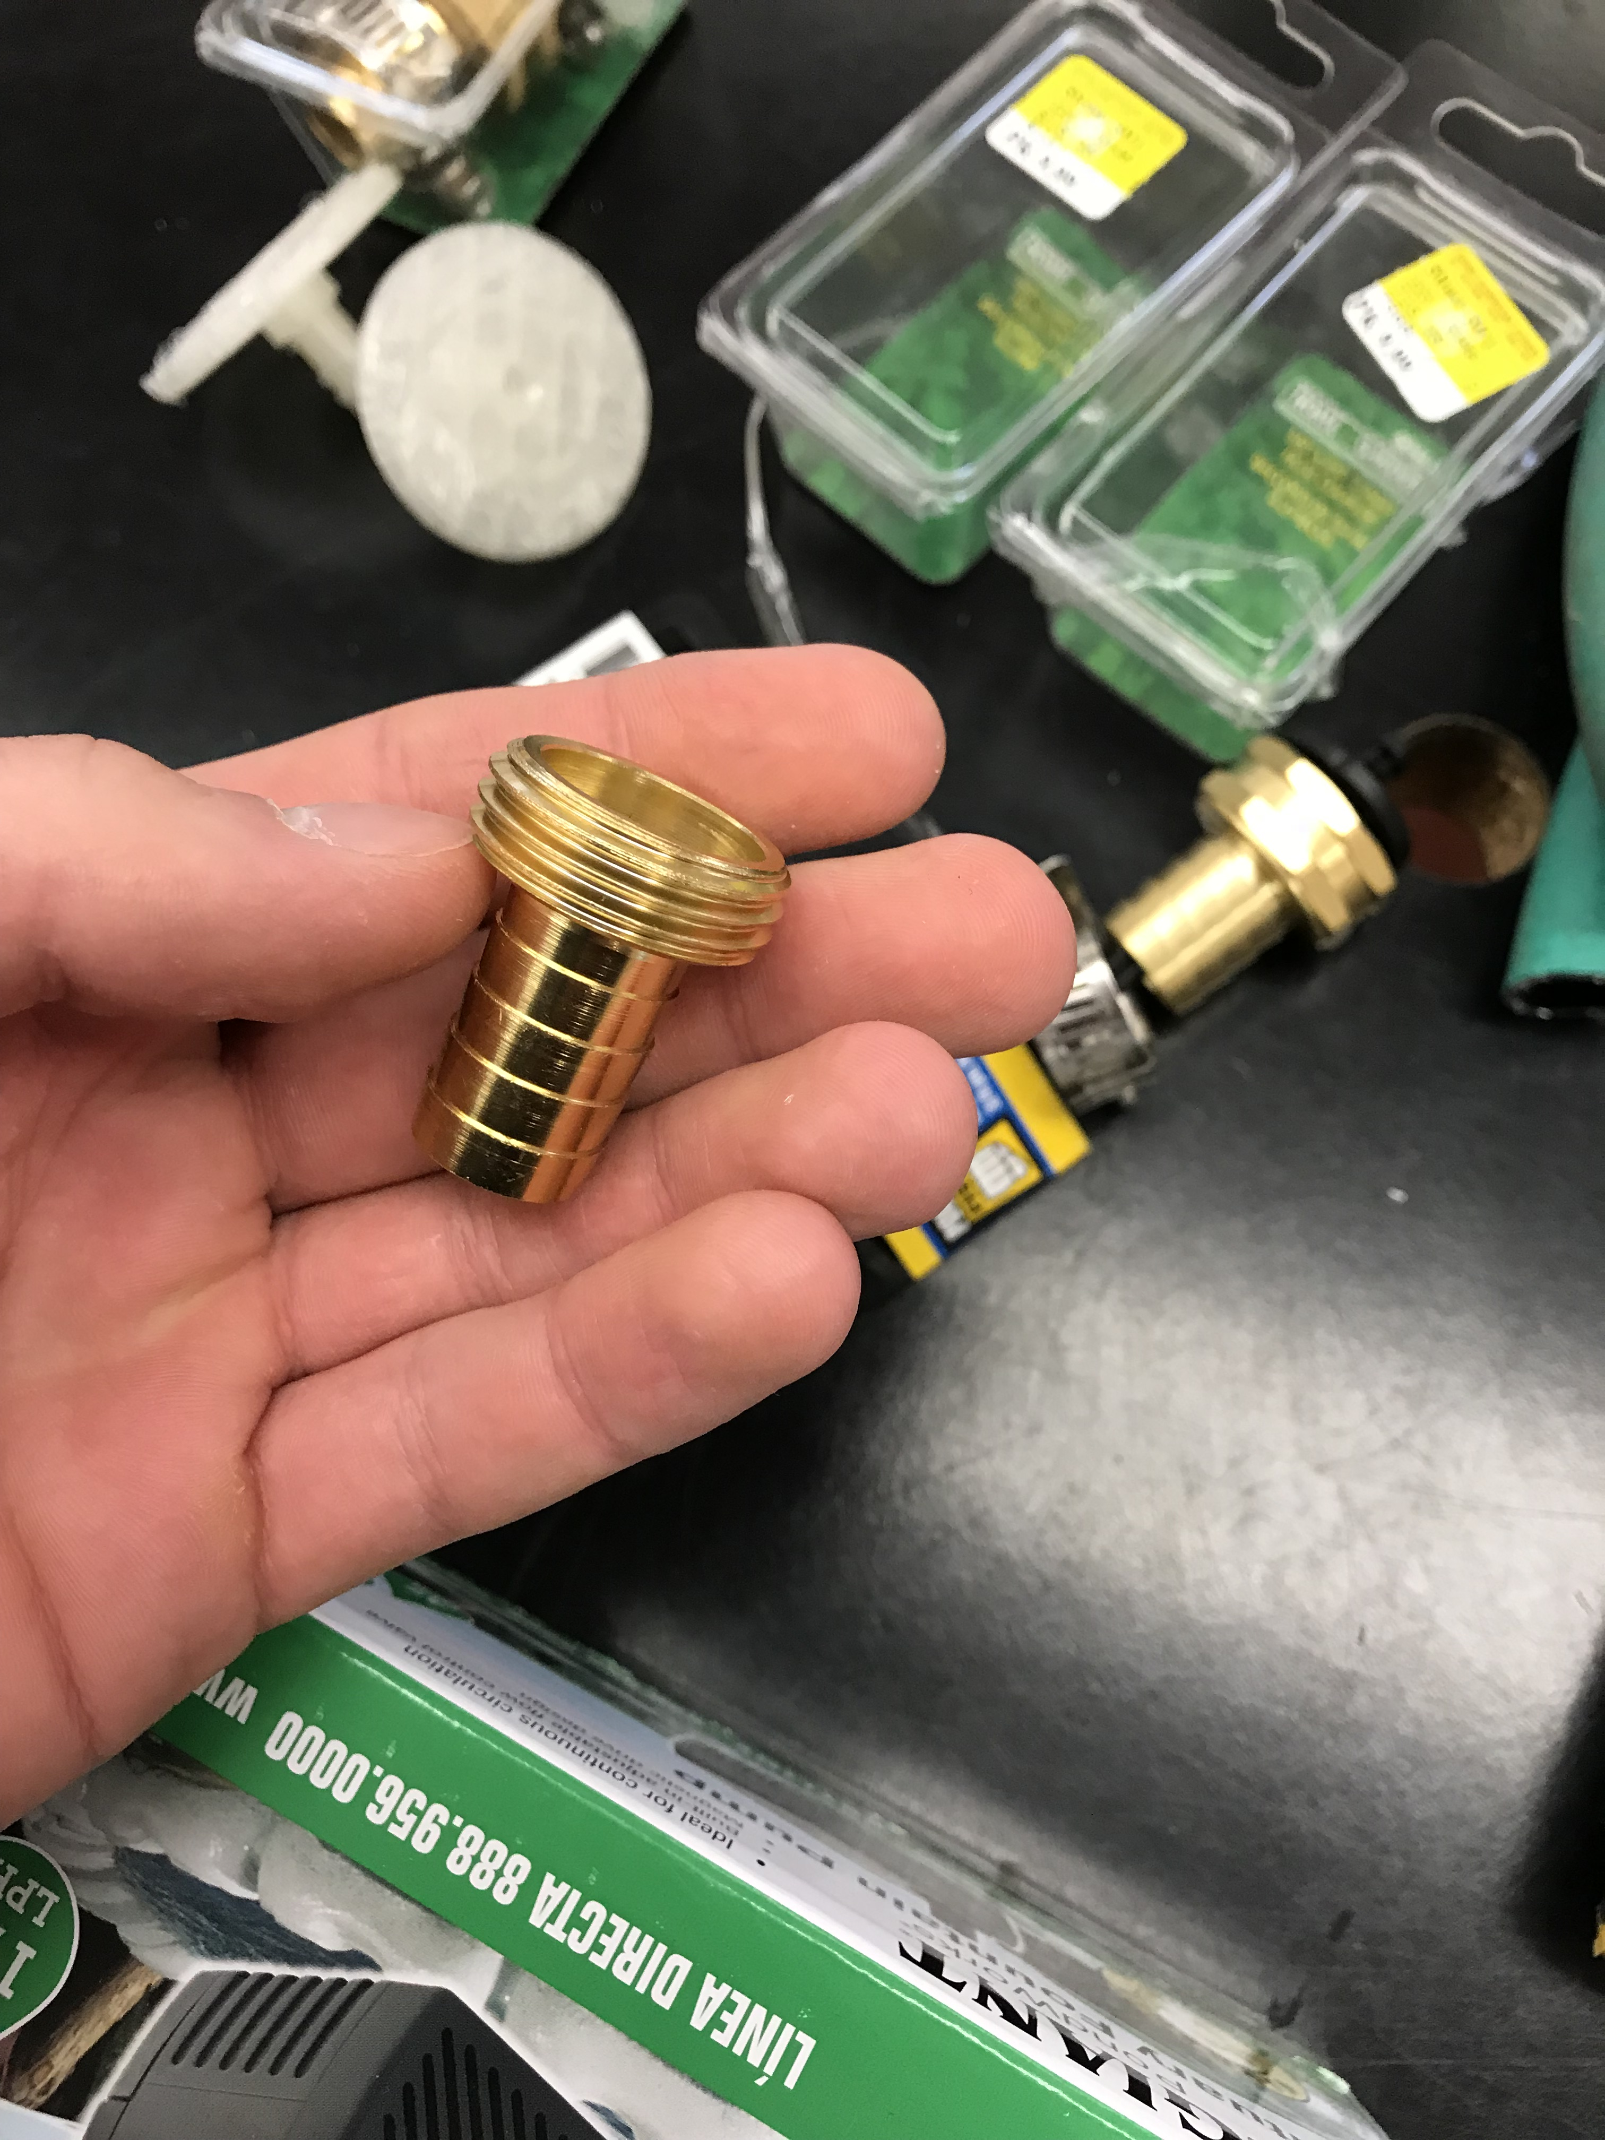
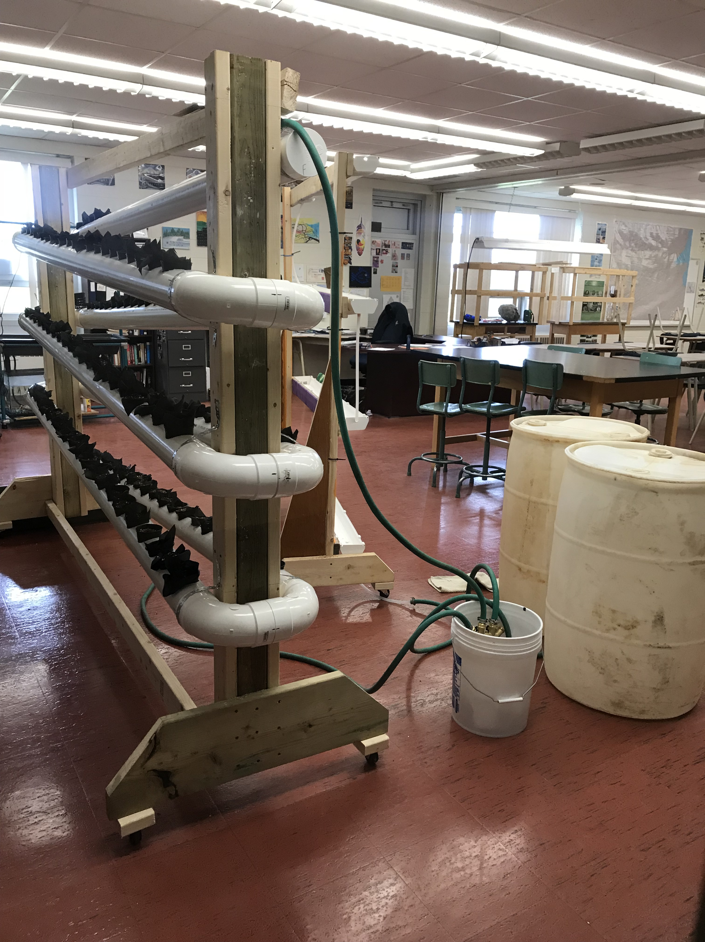
The final set up

