Slide 1
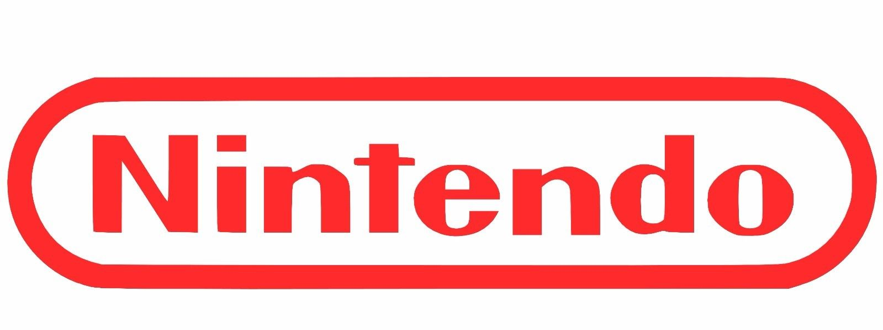
RetroMV
BY ROBBIE MACKAY & COLTON MANDEVILLE

Slide 2
What is our goal for the second project?
For the second project this semester our goal was to finish a project we both started off with two other project’s
Robbie started off with working on the sense hat for the high altitude balloon, then Logan from the other class took it on
Colton was working on a 3D printed shift nob
Then we both tried to work on the minty pi but sadly didn’t have the parts to finish it

Slide 3
So what did we get done?
So the both of us had a bunch of great ideas that ended up not working out, so we asked Mr. Hallihan what we should do..
He suggested to us that we both work together and fix all the retro arcade machine’s in the makerspace

Slide 4
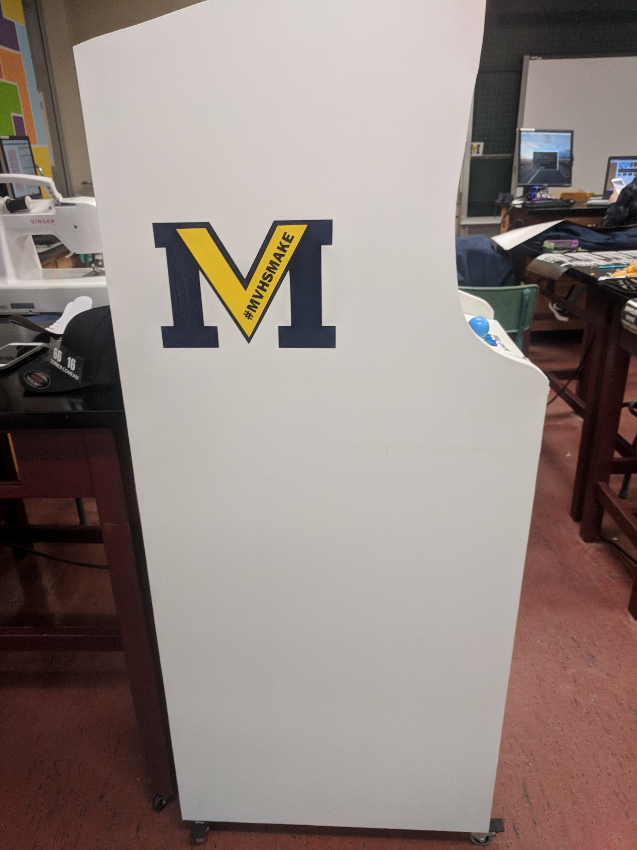
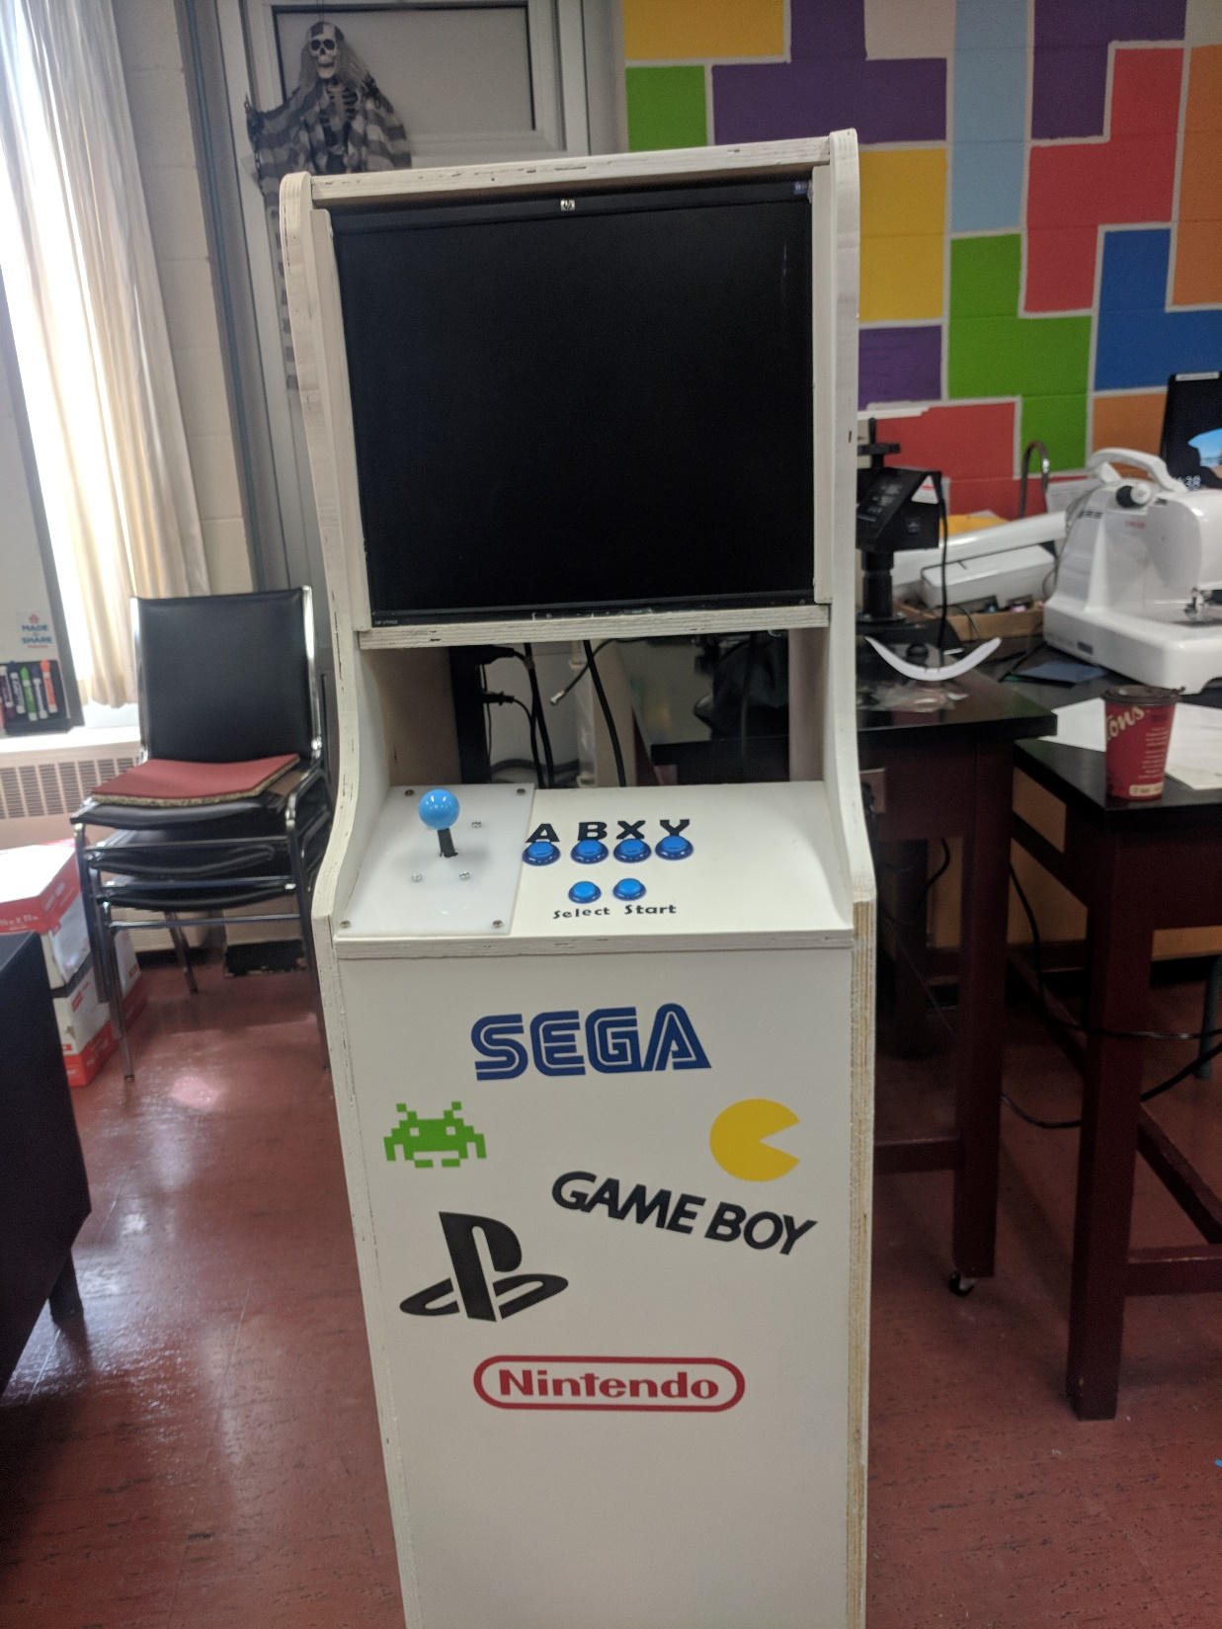
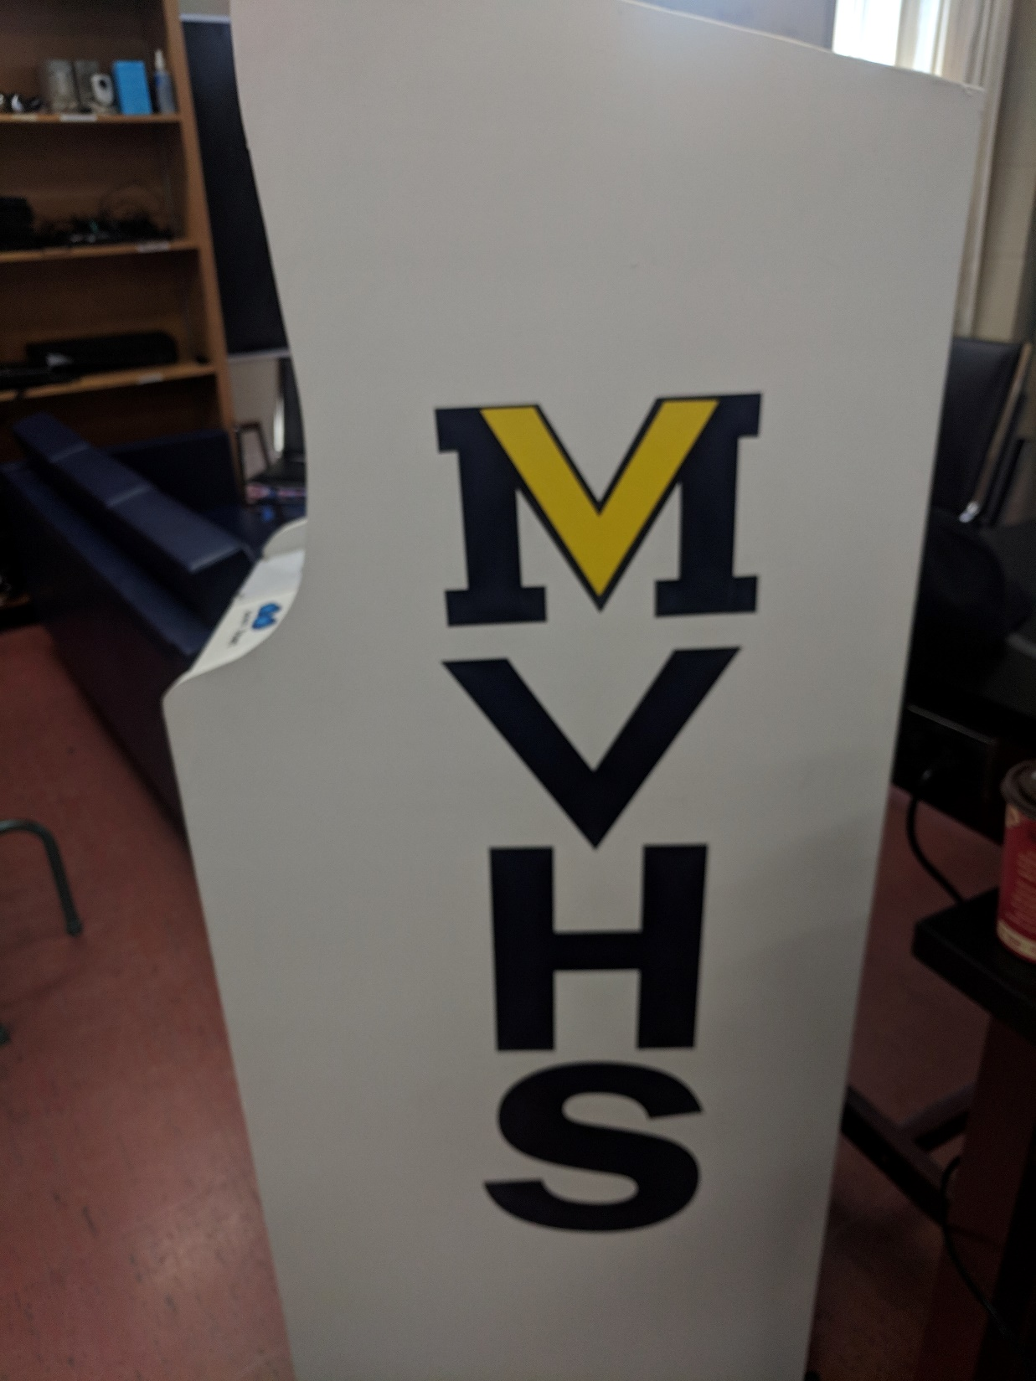
Troubleshooting
So the first problems we had was the white retro arcade machine the controller board wasn’t working and we couldn’t figure out what was wrong with it, until later on we noticed one of the cables was broken, so I had reimaged the retro pi micro SD card thinking it was that, but it actually wasn’t
In the end we used a Xbox controller until we can find a fix for the board

Slide 5
Troubleshooting… pt2
The other troubleshooting we had was, when making the speaker’s for the white retro arcade machine, we didn’t size it right so it was too small and the speaker’s didn’t fit.
So in the end what we ended up doing was using a xbox controller for the white retro arcade machine

Slide 6
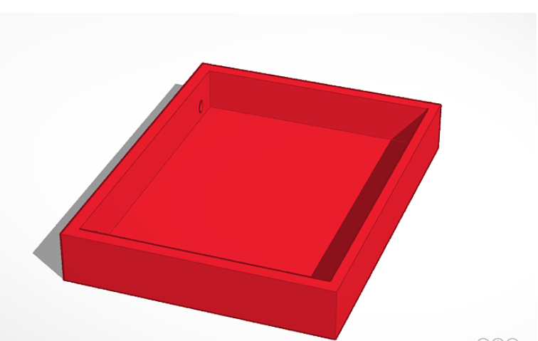
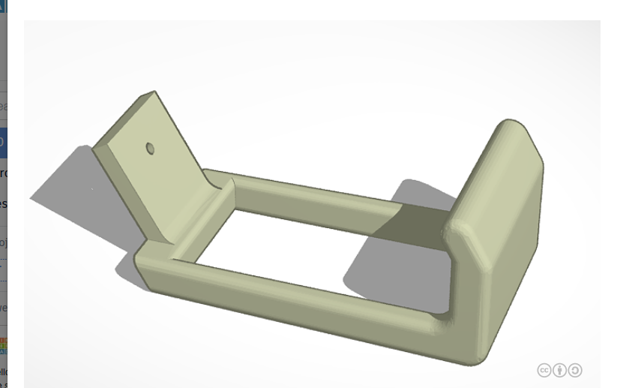
3D printed Items
The two 3d printed items we printed were the Xbox Controller holder and the speaker holder we have in the white retro arcade machine

Slide 7
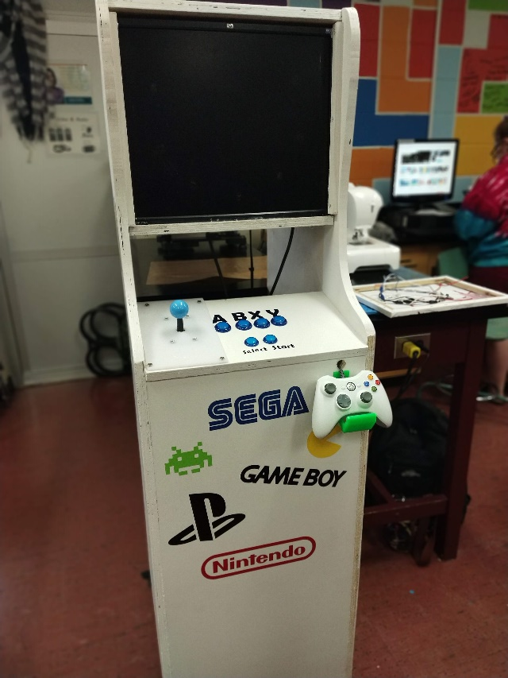
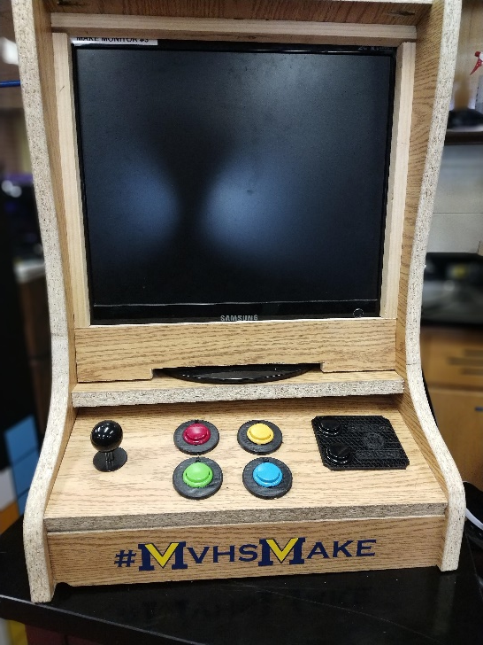
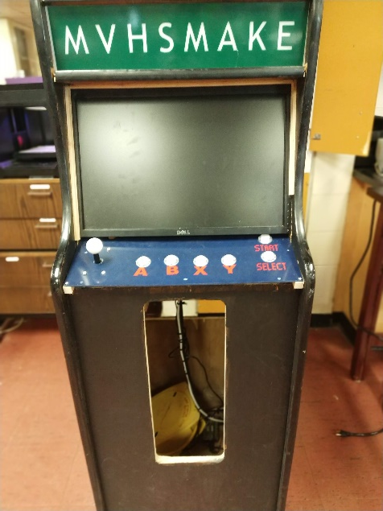
What we got done?
For the second project the both of us got all 3 of the retro arcade machine’s working
With all the games working

Slide 8
Demo
So for the demo today, were gonna show you how the retro arcade machine’s work

