Slide 1
Vr headset
Brettjardine

Slide 2
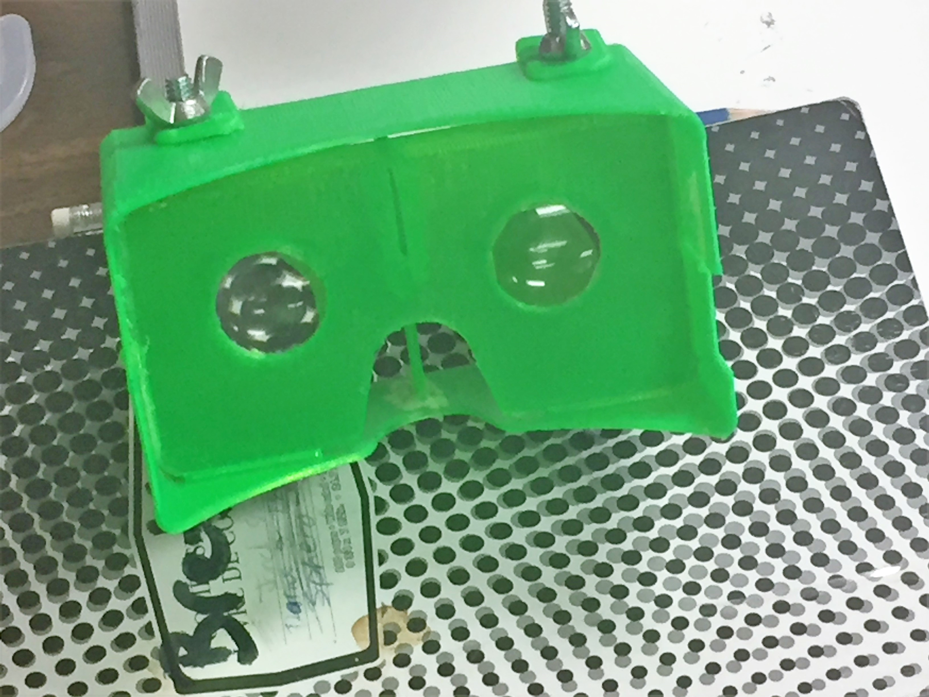
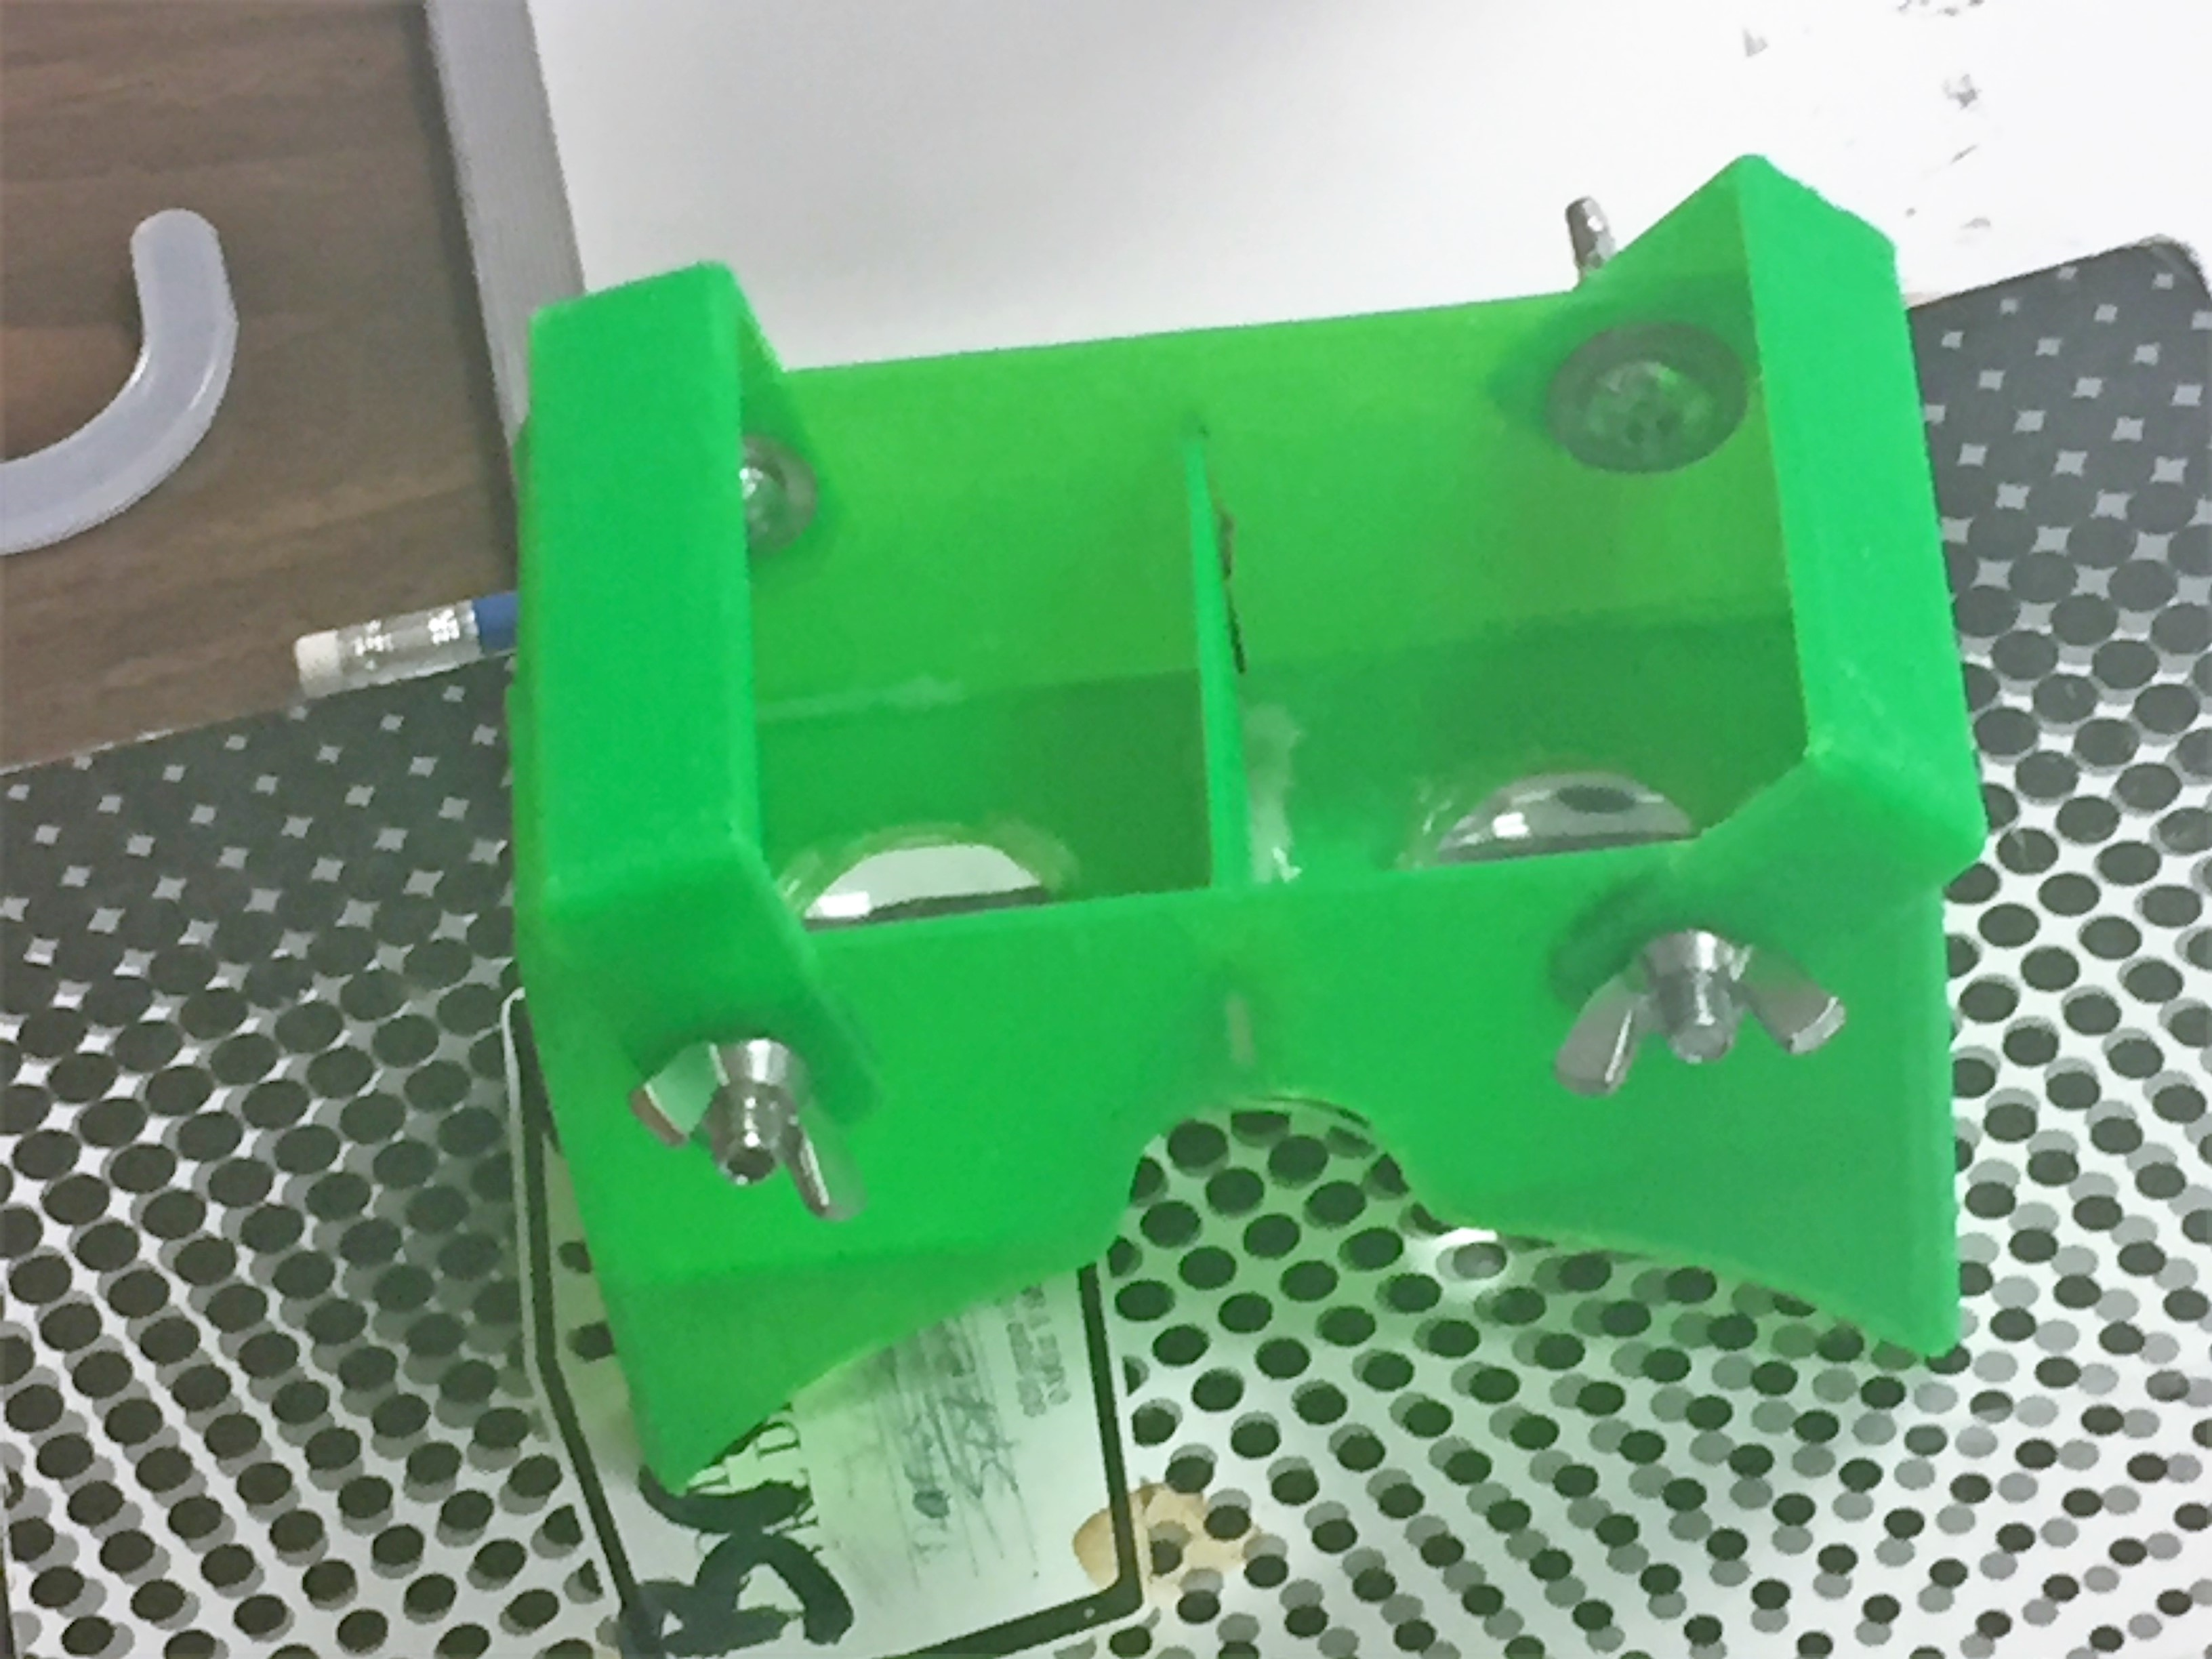
This is what mi Vr Headeset looks like

Slide 3
Step 1 – FINDING INSTRUCTIONS ‘HOW TO”
As the plans for Google Cardboard is free to download, or YouTube videos are available, anyone with enough patience can make a pair, although ordering them online is almost as cheap. However if you really want to get into the spirit of virtual reality then making a customized set for yourself is worth a go, and will also help you understand a little more about how it works.

Slide 4
STEP 2 – MATERIALS NEEDED
Virtual reality goggles such as Google Cardboard are surprisingly simple, with many such as the Samsung Gear VR just being a holder for your smartphone and a pair of lenses.

Slide 5
STEP 3 – 3D PRINTING (PIECES)

Slide 6
STEP 4 – PUTTING IT ALL TOGETHER

Slide 7
STEP 5 – FINAL STEP…ENJOYING MY HEADSET

