Slide 1
Chemistry 111/112
Chemical Quantities

Slide 2
Measuring Matter
Chemistry is a quantitative science
There are three typical ways in which we measure the amount of something
By count
A dozen eggs
By mass
A kilogram of apples
By volume
2L of milk

Slide 3
Units
A number is useless in chemistry unless we have a unit to associate with it
When we know the units, we can convert from one representation to another
Ex. How many metres are in 5 km?
Typically, conversions are set up as a comparison
Ex. 1000m/1km, 4.184J/1 calorie

Slide 4
The Mole
Chemistry uses units that are extremely small/large
Ex. The number or mass of atoms, ions and molecules
A specific count has been given to these particles to represent a unit of measure
Mole
1 mole = 6.02 x 10²³ representative particles
Also called Avogadro’s number
A representative particle can be atoms, ions, molecules, formula units…

Slide 5
https://www.youtube.com/watch?v=TEl4jeETVmgHow big is a mole? (Not the animal, the other one.) - Daniel Dulek
https://What Is Avogadro's Number - The Mole | Chemistry for All | FuseSchool

Slide 6
Converting from RP to moles
Use the following conversion to make a unit change from moles to RP and vice versa
6.02 x 10²³ representative particles
1 mole
You can write the inverse of this conversion if you want to convert representative particles to moles

Slide 7
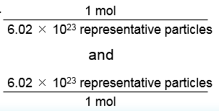
Converting from RP to moles or moles to RP

Slide 8
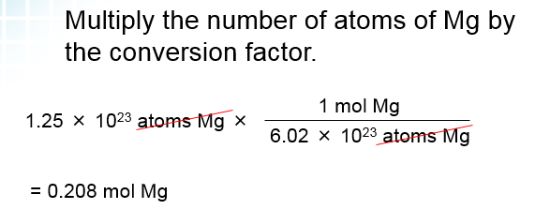
How many moles of magnesium is 1.25 × 10²³ atoms of magnesium?
1 mol Mg = 6.02 × 10²³ atoms Mg

Slide 9
Assignment/Homework
Page 291 #3 & 4
Significant Digits worksheet

Slide 10
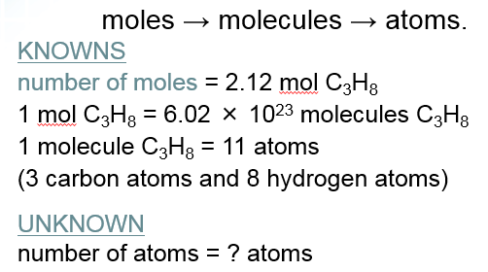
Sample problem 10.3

Slide 11
Assignment/Homework
Page 292 #5 & 6

Slide 12
Assignment/Homework
Page 292 #5 & 6

Slide 13
The Limits of Representative Particles
Chemists need a useful way of measuring the mass of substances
A conversion is needed to compare moles to mass
Molar mass is a measured amount (in grams) of one mole of pure substance
The chemical formula of a pure substance contains the type of element present as well as the relative amount
Calculate its mass based on its formula

Slide 14
Molar Mass
Ex. SO₃
Look up the individual atomic mass of each element on the periodic table
S = 32.06g/mol
O = 16.00g/mol
2. Multiply by the relative amounts
S = 32.06g/mol x 1 = 32.06g/mol
O = 16.00g/mol x 3 = 48.00g/mol
Add the values together
SO₃ = 32.06g/mol + 48.00g/mol = 80.06g/mol

Slide 15
Representing the Calculation
M_{SO3} = (1 x 32.06 g/mol) + (3 x 16.00g/mol)
= 80.06 g/mol

Slide 16
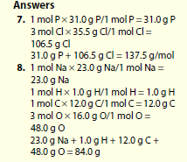
For the remainder of class…
Q. 7-15 – pg. 296 – take home task
Worksheet on Molar Mass (complete for tomorrow’s class)

Slide 18
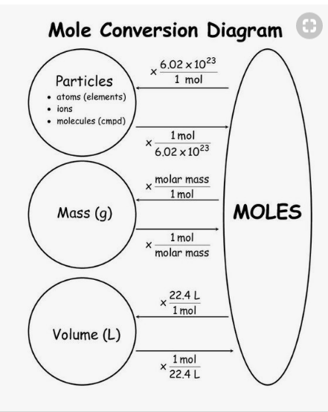

Slide 19
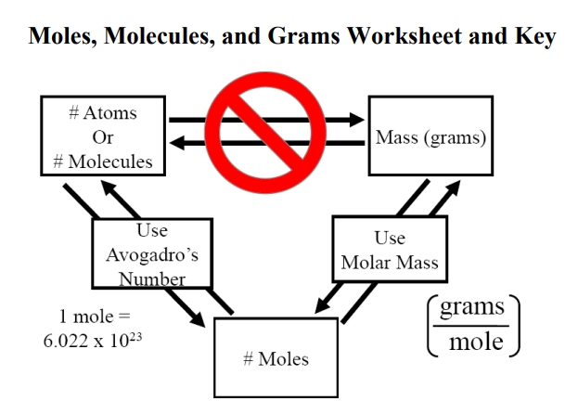

Slide 20
For the remainder of class…
1. Q. 7-15 – pg. 296 – take home task
2. Worksheet on Molar Mass (complete for tomorrow’s class)
3. Moles worksheet
4. Moles to particles (atoms or molecules)

Slide 21
For the remainder of class…
Q. 7-15 – pg. 296 – take home task
Worksheet on Molar Mass (complete for tomorrow’s class)

Slide 23
