Slide 1
Chemistry 122
Neutralization Reactions

Slide 2
Acid-Base Reactions
When an acid and base mix, if the number of hydrogen ions is EQUAL to the number of hydroxide ions, a neutral solution results.
This typically only happens with strong acids and strong bases.

Slide 3
Neutralization Reactions
An acid-base reaction in which a salt and water are products is a neutralization reaction.
A salt is a compound where the anion comes from an acid and cation comes from the base.
The hydronium (hydrogen ion) and the hydroxide ion combine to form water.

Slide 4
Neutralization Reactions
When an acid and a base mix, and the hydrogen ions equal the hydroxide ions in the solution, the equivalence point is met.
Mole ratio is valuable in determining the number of moles required of the base/acid for all of the acid/base to react.

Slide 5
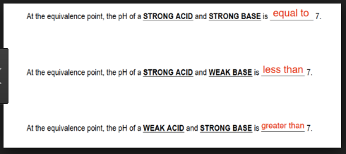

Slide 6
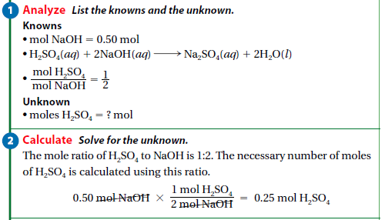
Example
H₂SO_{4(aq)} + 2NaOH_{(aq)} → 2H₂O_{(l)} + Na₂SO_{4(aq)}
How many moles of sulfuric acid are needed for 0.50 mol of sodium hydroxide to completely react?
n_{sulfuric acid} = 0.50mol x ½
= 0.25mol
Q. 30,31, p. 614

Slide 7
Q. 30,31, p. 614

Slide 8
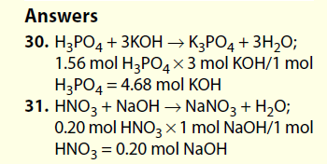

Slide 9
Steps in a Neutralization Reaction: Titration
A measured volume of an acid solution of unknown concentration is added to a flask.
Several drops of an indicator are added to the solution while the flask is gently swirled.
Measured volumes of a base of known concentration are mixed into the acid until the indicator just barely changes colour.

Slide 10
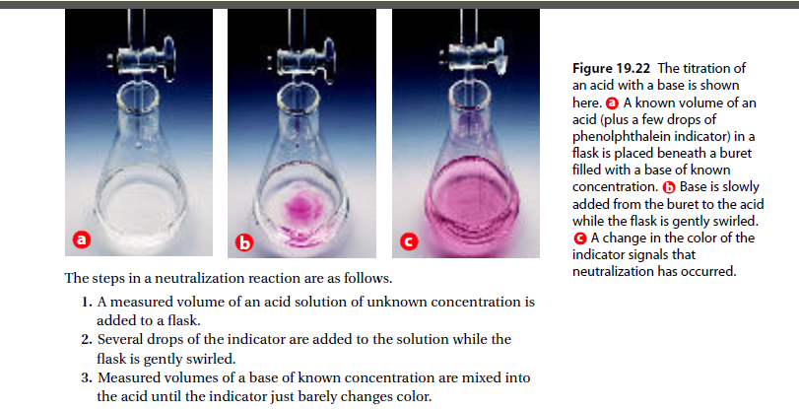

Slide 11
Definitions
The solution of known concentration is called the standard solution.
This solution is added to the unknown concentration through a buret.
Once the neutralization takes place, there is a colour change, and endpoint is achieved.
Neutralization means the pH is 7.
At this point, there is only water and salt present in the solution.

Slide 12
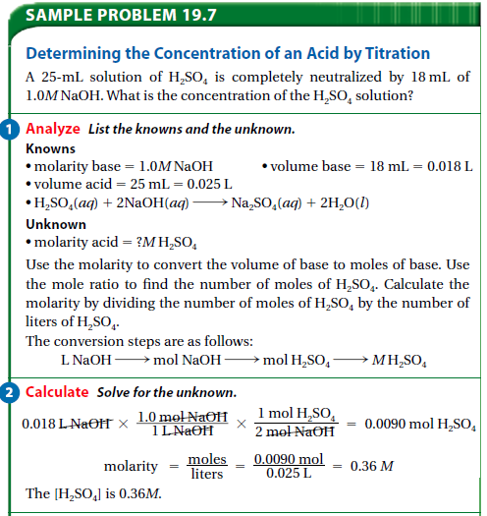

Slide 13
Experimental vs. Derived Concentrations
Titrations can be performed in the lab as well as determined through calculations.
Ex. Page 616
Q. 32, 33, 36, 37 p. 616

Slide 14
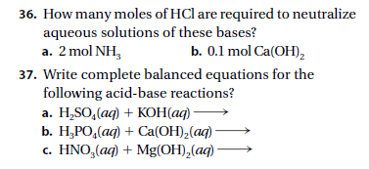
Q. 32, 33, 36, 37 p. 616

Slide 15
