Slide 1
Chemistry 122
Hydrocarbon Compounds
Fuse School
Intro to hydrocarbonshttps://www.youtube.com/watch?v=LNSlSEJdMrU -

Slide 2
Organic Chemistry and Hydrocarbons
It was once believed that only living things could synthesize carbon
Wohler disputed this when he was able to synthesize urea from inorganic material
Organic chemistry is the study of carbon-based compounds, regardless of their origin
The simplest form of organic compounds are hydrocarbons – containing hydrogen and carbon
Ex. Methane (CH₄) and ethane (C₂H₆)

Slide 3
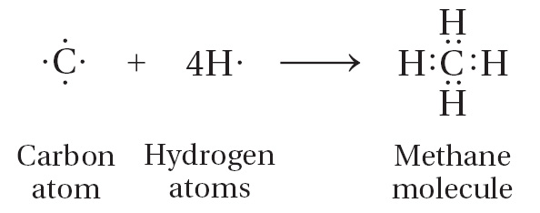
The Structure of Hydrocarbons
Carbon has four valence electrons
the outermost e- of an atom’s structure
It forms four covalent bonds in various combinations
Sharing electrons with other atoms

Slide 4
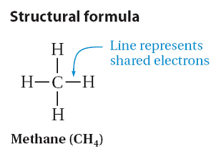
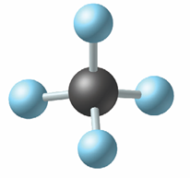
Different Ways of Representing Organic Compounds
Structural formulas write the symbol of the atom with a line to represent the shared pair of electrons
Ball-and-stick models, as well as space-filling models, help represent the 3D structure of the compound

Slide 5
Alkanes
An alkane is a hydrocarbon in which there are only single covalent bonds
The bonds are nonpolar due to the small difference in electronegativities between C - H
Smaller molecules have low boiling points; as the size of the molecule increases, so does its boiling point
There are either carbon-carbon bonds or carbon-hydrogen bonds
The molecule can be arranged in a straight line or in a chain that has branches

Slide 6
Straight Chain Alkanes
Can contain any number of carbon atoms but they must form a continuous chain
Known as a homologous series because of its constant increment in molecular structure from one compound to the next
CH₂ is the increment for alkanes
You can use the formula C_{n}H_{2n+2} to determine the formula

Slide 8
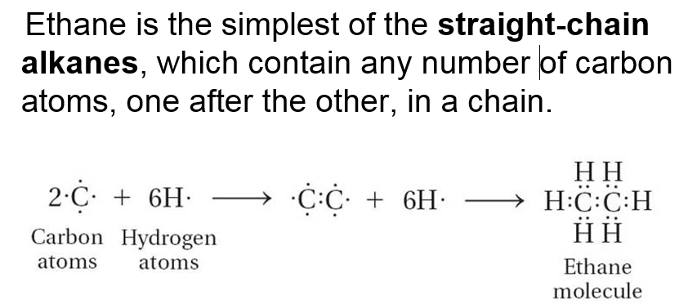

Slide 9
Rules for Naming and Drawing Straight Chain Alkanes
Set up by the IUPAC
All alkanes end in –ane
From one to four carbon atoms in the formula, the names are: methane, ethane, propane and butane
If an alkane has more than four carbon atoms, then the prefix system applies (penta -, hexa-, hepta, octa, nona, deca)
To draw the structural formula, write the appropriate number of carbon atoms in a straight chain, and then add hydrogen
They can be condensed (some bonds are left out)

Slide 10
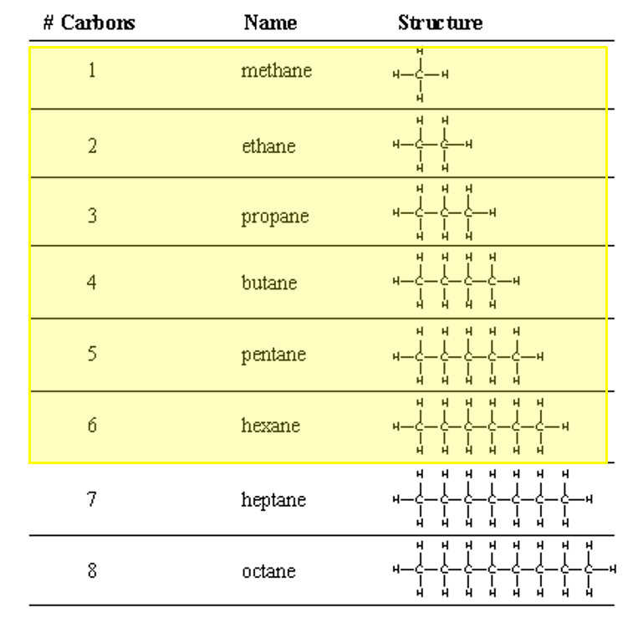

Slide 11
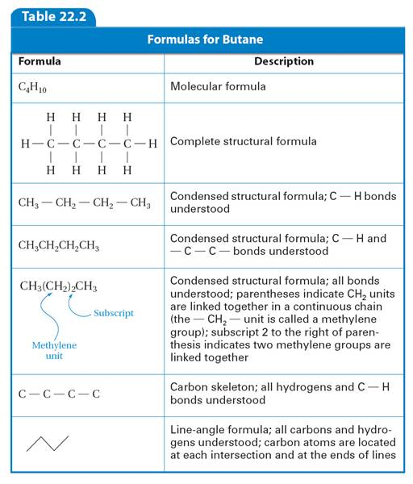

Slide 12
Page 697 #1 & 2

Slide 13
Page 697 #1 & 2

Slide 14
Naming and Drawing Branched-Chain Alkanes
Carbon can bond with other carbon atoms that are not necessarily in a continuous line
When a hydrocarbon group is attached to a carbon atom in a straight line, it is referred to as a substituent – also called an alkyl group
The longest chain of carbon atoms is called the parent alkane
All other parts of the chain are referred to as substituents

Slide 16
Alkyl Groups
The –ane is removed from the name of the parent chain and the suffix –yl is added
A hydrogen is removed from the formula
Ex. CH₄ = methane, CH₃ = methyl

Slide 17
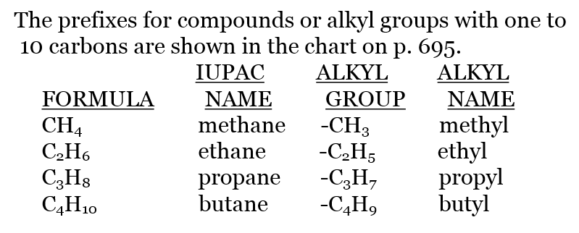

Slide 18
Branched-Chain Alkanes
The name is based on the longest continuous chain of carbon
Each alkyl substituent is identified based on its position on the parent chain
The carbon the alkyl is attached to is identified based on the sequence that gives them the lowest numbers
Add the numbers they are attached to their alkyl name
If the particular alkyl appears more than once, identify both its position and use the prefix system (di-, tri-, tetra-)
Alphabetize the alkyl groups (on the root word, not the prefix)
Use proper punctuation – commas separate numbers, hyphens separate numbers and names
Do not include spaces

Slide 21
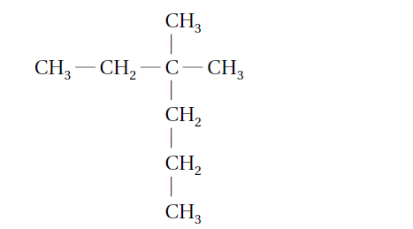
Example – page 699
Notice that the parent alkane, in this case, is not written in a straight line – sometimes you have to look for the longest continuous chain
Count off the number of carbon atoms in the parent chain and identify it
Identify the sequence that gives the lowest number
Identify the alkyl groups

Slide 22
Draw the Alkane
3,3-dimethylhexane
Questions 3, 4, page 699

Slide 23
Extra Practice
Practice – Name the following compounds according to the IUPAC system p 699 3 & 4 P 700 5 & 6
A.
B.

Slide 24
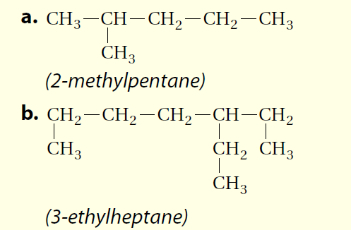

Slide 25
Drawing the Structural Formula from the Name
Working backwards –
Draw the parent chain
Draw your branches. Don’t forget to subtract H from your formulas as you add branches
Ex. Page 700

Slide 27
Page 700 Q 5 & 6

Slide 28
For the remainder of class…
Practice on naming and drawing alkanes
Questions
3 – 4 page 699
5 – 6 page 700
7 – 12, page 701
Guided reading for section 22.1

