Slide 1
Chemistry 121/122
Salts in Solution

Slide 2
Acid-Base Combinations
Not all salts are neutral – some can be basic, others acidic
When a strong acid reacts with a strong base, the equivalence point is neutral (pH = 7)
All of the H⁺ and OH⁻ ionize – forming water and salt

Slide 3
Salt Hydrolysis
Some salts promote hydrolysis
The cation or the anion of the dissociated salt remove H+ ions or donate H+ to water
As a result, the salt may be acidic or basic
Form from a strong acid/weak base or a strong base/weak acid combination

Slide 4
Salt Hydrolysis
Salts that produce acidic solutions contain positive ions that release protons in water
Ex. Ammonium chloride (comes from hydrochloric acid and ammonia)
Salts that produce basic solutions contain negative ions that attract protons from water
Ex. Sodium ethanoate (comes from ethanoic acid and sodium hydroxide)

Slide 6
Example
NaCH₃COO → CH₃COO⁻ + Na⁺
CH₃COO⁻ + H₂O → CH₃COOH + OH⁻
1. sodium acetate is the salt of a weak acid and a strong base (there will be hydroxide ions in the dissociated solution)
2. Acetate assumes a negative charge once dissociated and therefore a Bronsted-Lowry base (hydrogen ion acceptor)
3. The acetate is available to combine with the hydrogen ions from water which will then produce an acid and hydroxide ions

Slide 7
Why is this called hydrolysis?
A hydrogen splits off of the water and attaches itself to the anion
The resulting solution contains more hydroxide ions greater than the concentration of hydrogen ions
Thus, the solution is basic

Slide 8
Summary
Strong acid + strong base = neutral solution
Strong acid + weak base = acidic solution
Weak acid + strong base = basic solution

Slide 9
Determining if a Salt is Acidic, Basic, or NeutralDetermining if a Salt is Acidic, Basic, or Neutral

Slide 10
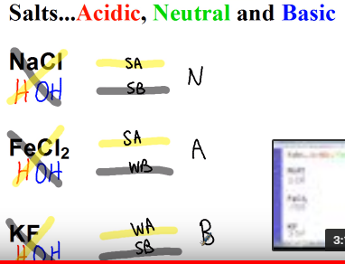

Slide 11
Practice
Write equations for the salt hydrolysis reactions that occur when the following salts are dissolved in water. Classify each solution as acidic, basic or neutral.
a. ammonium nitrate
b. rubidium acetate
c. potassium sulfate
d. calcium carbonate

Slide 12
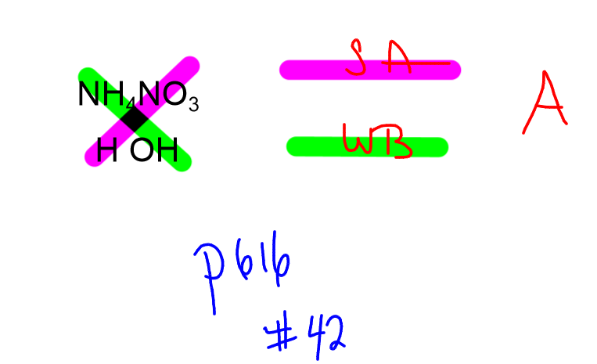
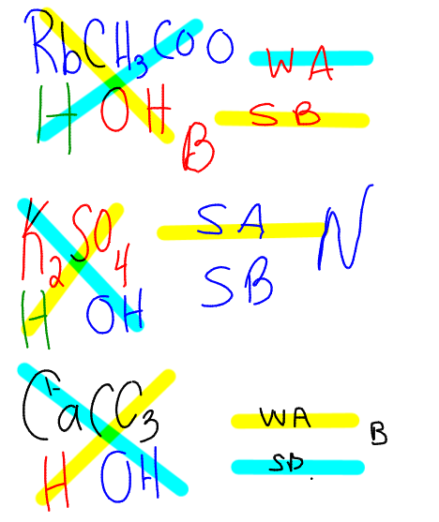

Slide 13
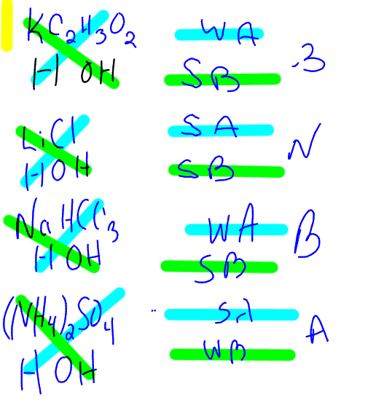
P 622 #42

Slide 14
Buffers
A solution in which the pH remains relatively constant when small amounts of acid or base are added
A buffer is a weak solution of a weak acid and one of its salts, or a solution of a weak base and one of its salts
All buffers have limits to their capabilities - this is called its buffer capacity

Slide 15
Remainder of class…
Questions 38, 39, 42, 43 – page 622
Test on Friday, May 18

Slide 16
Easy way to memorize the 7 strong acids and 6 strong bases
Acid-base properties of salts | Acids and bases | Chemistry | Khan Academyhttps://www.youtube.com/watch?v=HwkEQfsJenk
Salts in Solutionhttps://www.youtube.com/watch?v=O9-n_mDqGMk

