Slide 1
Chemistry 121/122
Entropy and Free Energy

Slide 2
Free Energy and Spontaneous Reactions
Many times, the energy (heat) released from a chemical reaction can be used to bring about other changes
This energy is considered to be free energy
In any chemical reaction, some energy is always lost
This is energy inefficiency of a chemical reaction
The theoretical amount of energy available may not be equal to the actual energy in a chemical reaction
Even though we can theoretically write a balanced chemical equation, it may or may not actually happen

Slide 3
Free Energy and Spontaneous Reactions – cont'd
Therefore, there are two kinds of reactions
Those that occur (under present conditions) and those that do not occur
Spontaneous reactions occur naturally and favour the formation of products at the specified conditions
They produce substantial amounts of products at equilibrium and release free energy
Nonspontaneous reactions are those that do not favour the formation of products at the specified conditions

Slide 4
Example
H₂CO_{3(aq)} ↔ CO_{2(g)} + H₂O_{(g)}
< 1% >99%
In the decomposition of carbonic acid, the forward reaction is spontaneous; more than 99% of the reaction turns to products at equilibrium
This means less than 1% is carbonic acid
In this case, the products are favoured in the forward reaction. The combination of carbon dioxide and water to form carbonic acid is nonspontaneous
When the reaction is spontaneous, free energy is released

Slide 5
Spontaneous Reactions – cont'd
The speed of a reaction does not influence whether a reaction is spontaneous or not
If a nonspontaneous reaction is in the presence of a spontaneous reaction, the energy released can be used to fuel the nonspontaneous reaction
This is referred to as coupled reactions

Slide 6
Entropy
Entropy is a measure of disorder of a system
The law of disorder (entropy change) states that the natural tendency of a system is to move in the direction of maximum disorder or randomness
Otherwise known as the second law of thermodynamics
An increase in entropy favours spontaneous reactions; a decrease favours nonspontaneous

Slide 7
Entropy - continued
How entropy can be increased in a system:
State of matter changes from a solid-liquid-gas
System is divided into parts (forms a solution)
Total number of product molecules is greater than the total number of reactant molecules
Temperature increases

Slide 8
Examples of Entropy
What has more entropy – a solid block of ice or a pot of boiling water? Why?
There is an increase in atmospheric carbon dioxide. It is occurring because oceans are getting warmer. What happens to the amount of CO₂ in warm water compared to cold water? How can this be related to spontaneous/nonspontaneous reactions? Which variable is being altered in this example?

Slide 9
Enthalpy, Entropy, and Free Energy
In some chemical reactions, heat is either being absorbed or released and entropy is either being increased or decreased
Both enthalpy (∆H) and entropy (∆S) changes together determine whether a reaction will be spontaneous
Whether products are favoured and there is a release of free energy
Exothermic reaction with an increase in entropy will always be spontaneous
A decrease in entropy offset by an substantial release of heat will also be spontaneous

Slide 10
Enthalpy and Entropy – the happy couple
An endothermic reaction can also be spontaneous if it is offset by a large entropy difference
Either of the two variables working against one another may influence the spontaneity of a reaction
Table 18.3, p. 571
Figure 18.25, p. 572

Slide 11
p. 571

Slide 12
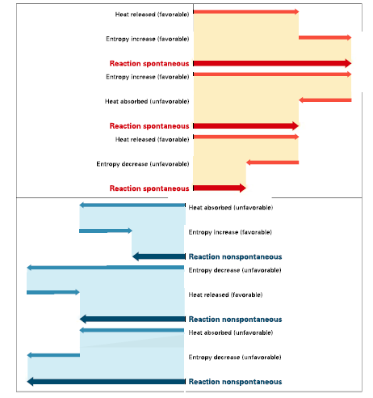

Slide 13
Answer these questions while looking at the visual representations
1. What changes can occur during a reaction to always favour spontaneity?
2. Under what conditions is a reaction least likely to be spontaneous?
3. What happens when one change favours spontaneity and one change does not?

Slide 14
Gibbs Free Energy
In every spontaneous reaction, some energy is released to do work
This energy is called Gibbs free-energy change
It is the maximum amount of energy that can be coupled to another process to do useful work
A formula can be used to determine the amount of free energy available from a reaction
ΔG = ΔH - TΔS

Slide 15
What does the formula mean?
The value of ΔG is negative in spontaneous processes because the system loses free energy
The conditions may determine whether a reaction is spontaneous or not
T = temperature in Kelvin
ΔS = change in entropy
ΔH = change in enthalpy
ΔH and ΔS are assumed to be held at a constant for the same reactions at different temperatures.

Slide 16
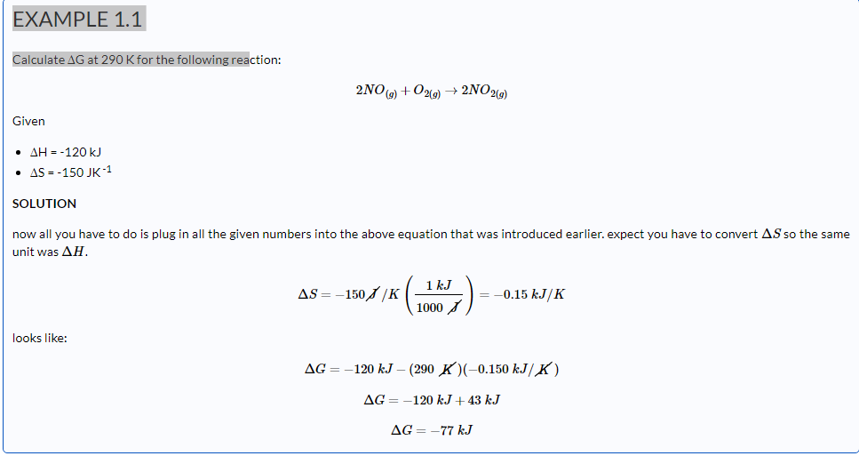

Slide 17
The remainder of class…
Guided reading for Section 18.4
Questions 33 – 35, page 573
Section review
Interpreting graphics

