Slide 1
Four Directions
By: Brianna Mullin and Owen O’Neill

Slide 2
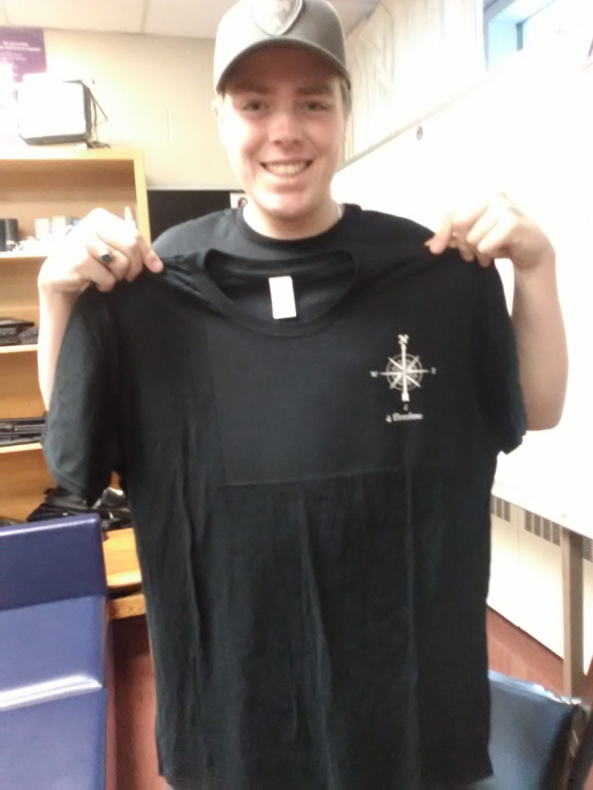
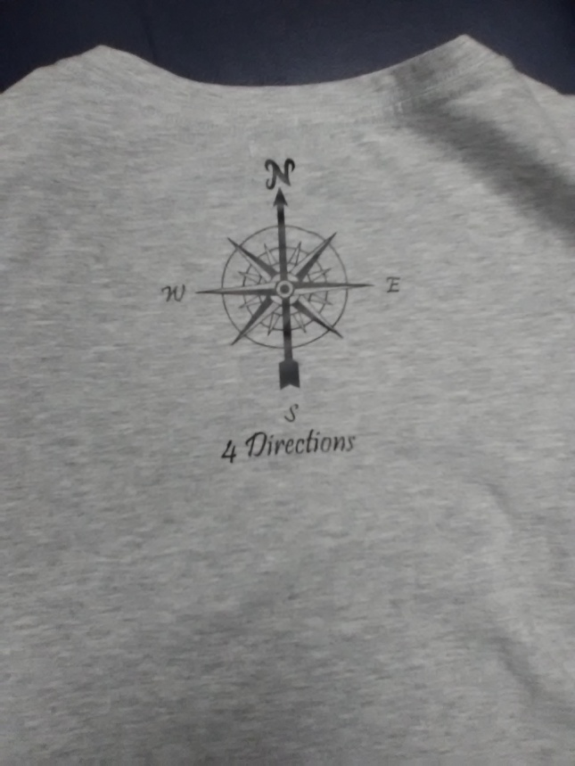
Main Ideas
Our main idea for this project was to create a logo and name for our own clothing brand.

Slide 3
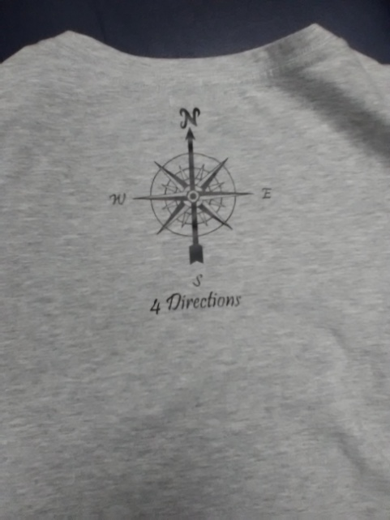
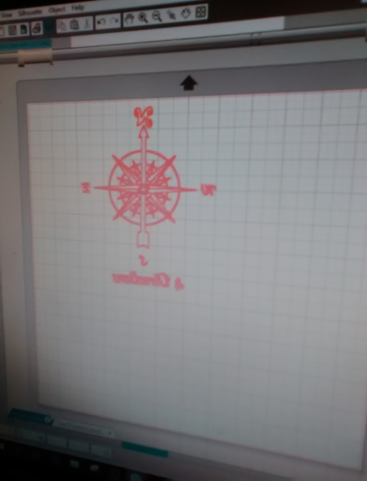
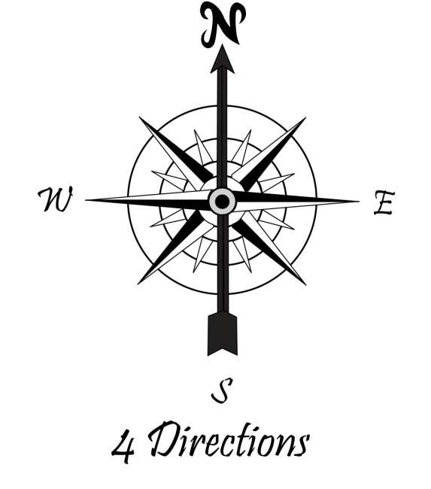
Our name & design
The design we came up with is a compass with all four directions on it.
The name we came up with was 4 Directions.

Slide 4
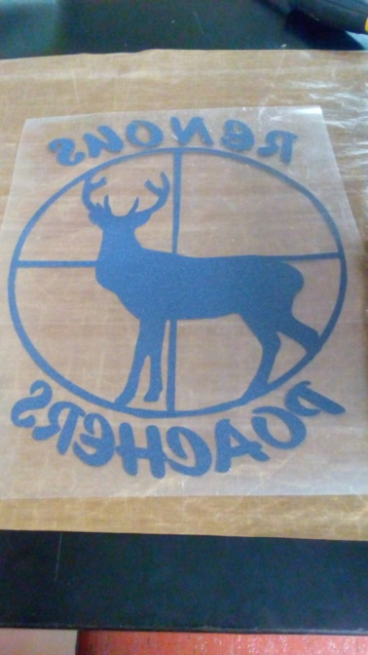
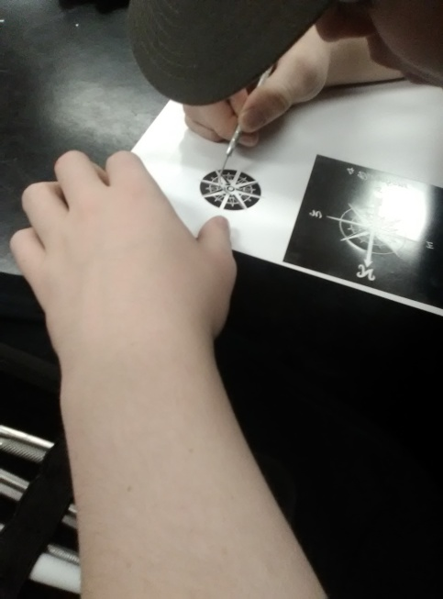
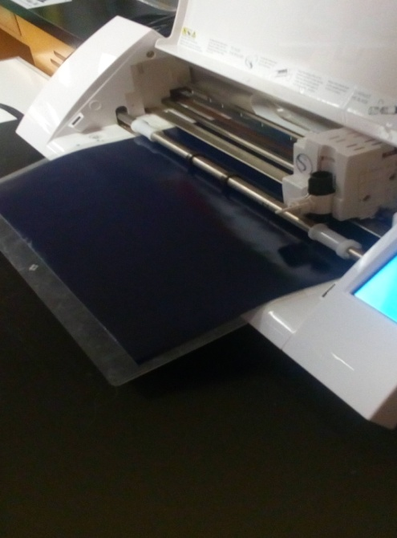
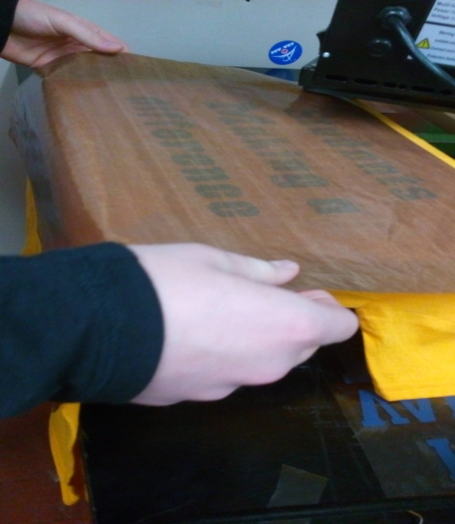
Things we learned
While doing this project we have learned how to do many things:
The Silhouette studio
How to peel the designs
How to use the heat press

Slide 5
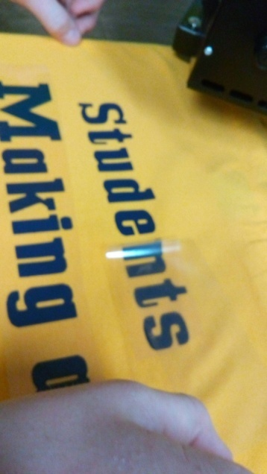
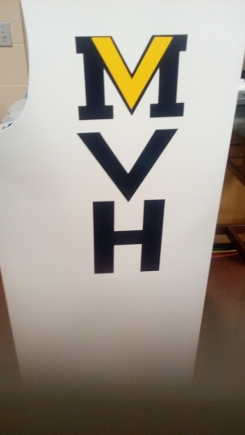
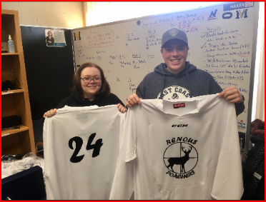
Other Projects We Did
While doing this project we also did and helped with other projects.
We helped the Miramichi Valley Rotary Club make T-shirts for We Day
We made stickers for the arcade machine &
We made jerseys for the Renous Poachers Hockey team.

Slide 6
Our Troubles
Throughout this project we didn’t really run into a lot problems, but we did have a few.
The handle wouldn’t stay down on the heat press
Our original name was already a name brand
At the end we had trouble with the vinyl cutter.

Slide 7
Our Goal
We would like to continue with our design outside of the Maker Space and sell our clothing and hopefully some day it will become a big brand.

