Slide 1
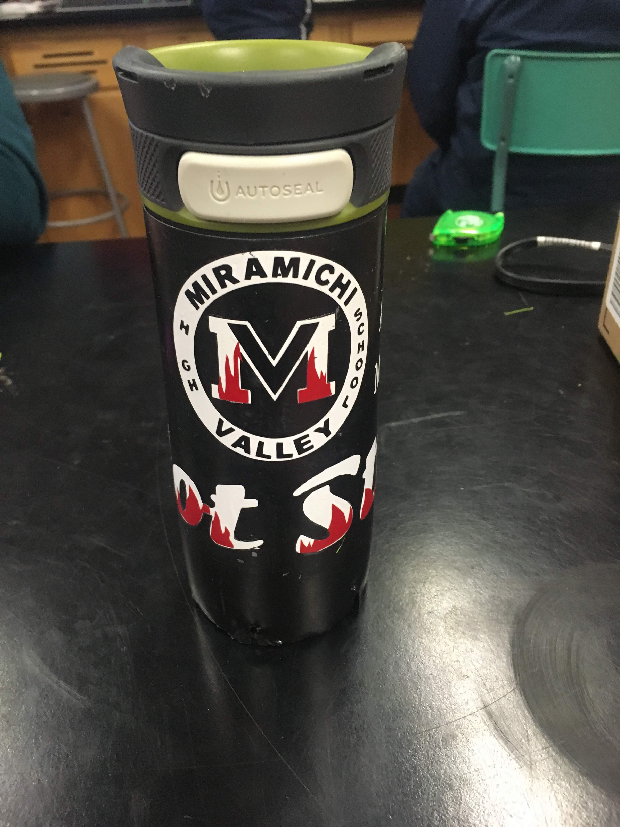
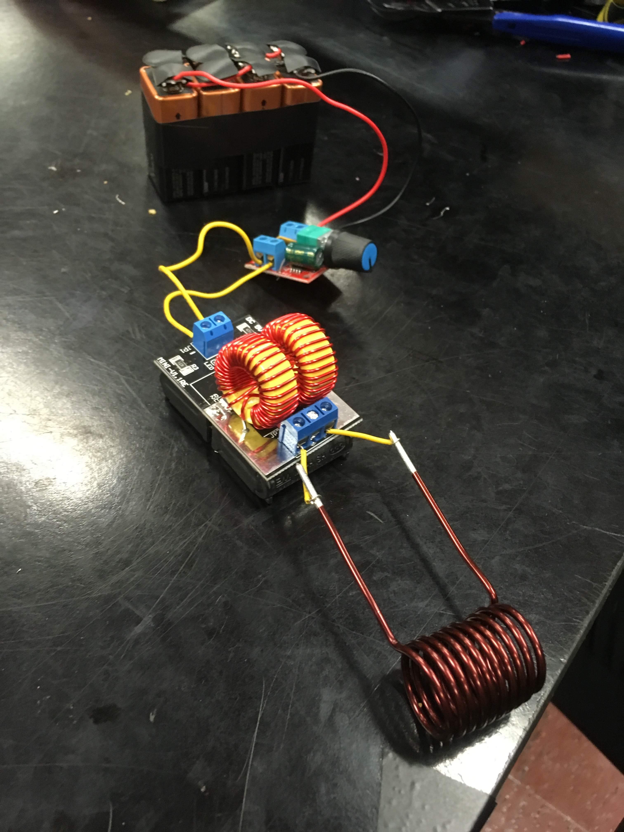
Hot Stuff
Alex Tozer & Mitchel Hallihan

Slide 2
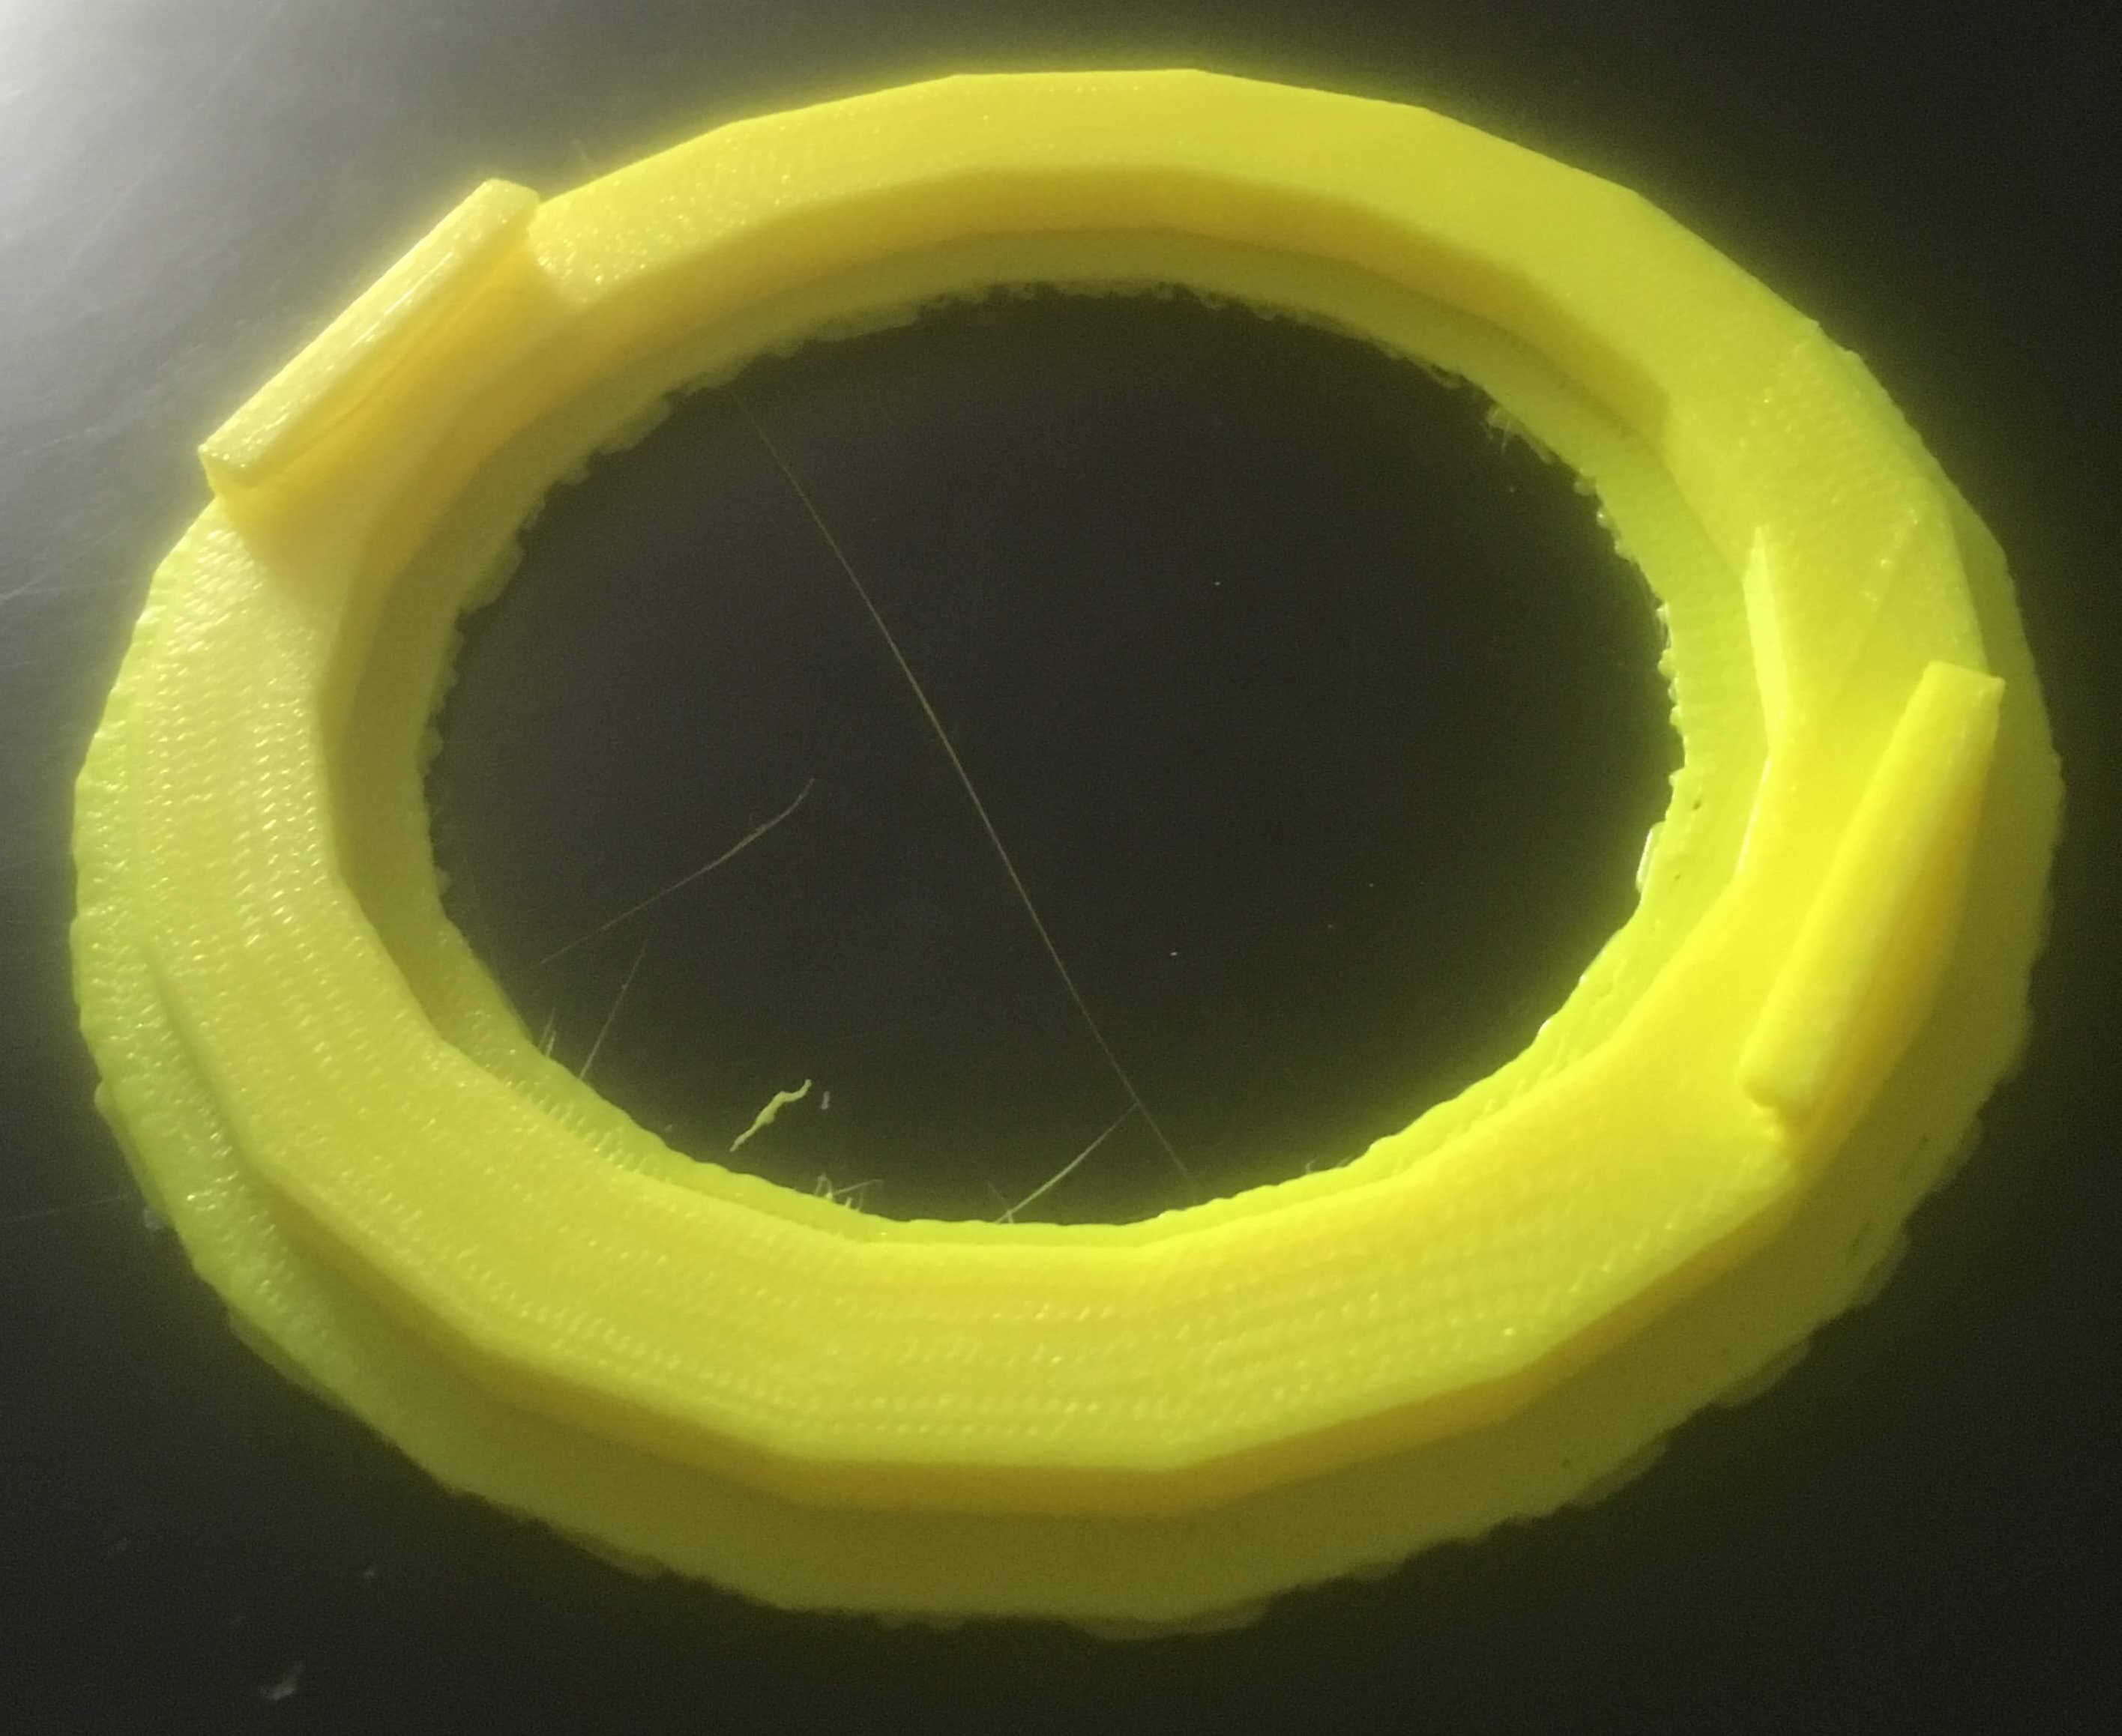
Goals
Make a sustainable heating unit using induction heating
3D design and print a container for the heating unit
Use heat vinyl to put decals on our cup

Slide 3
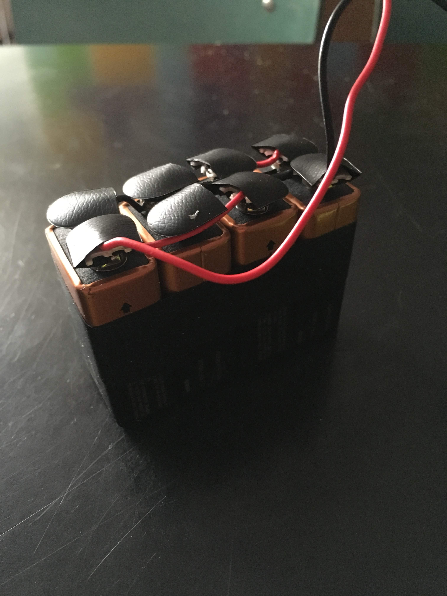
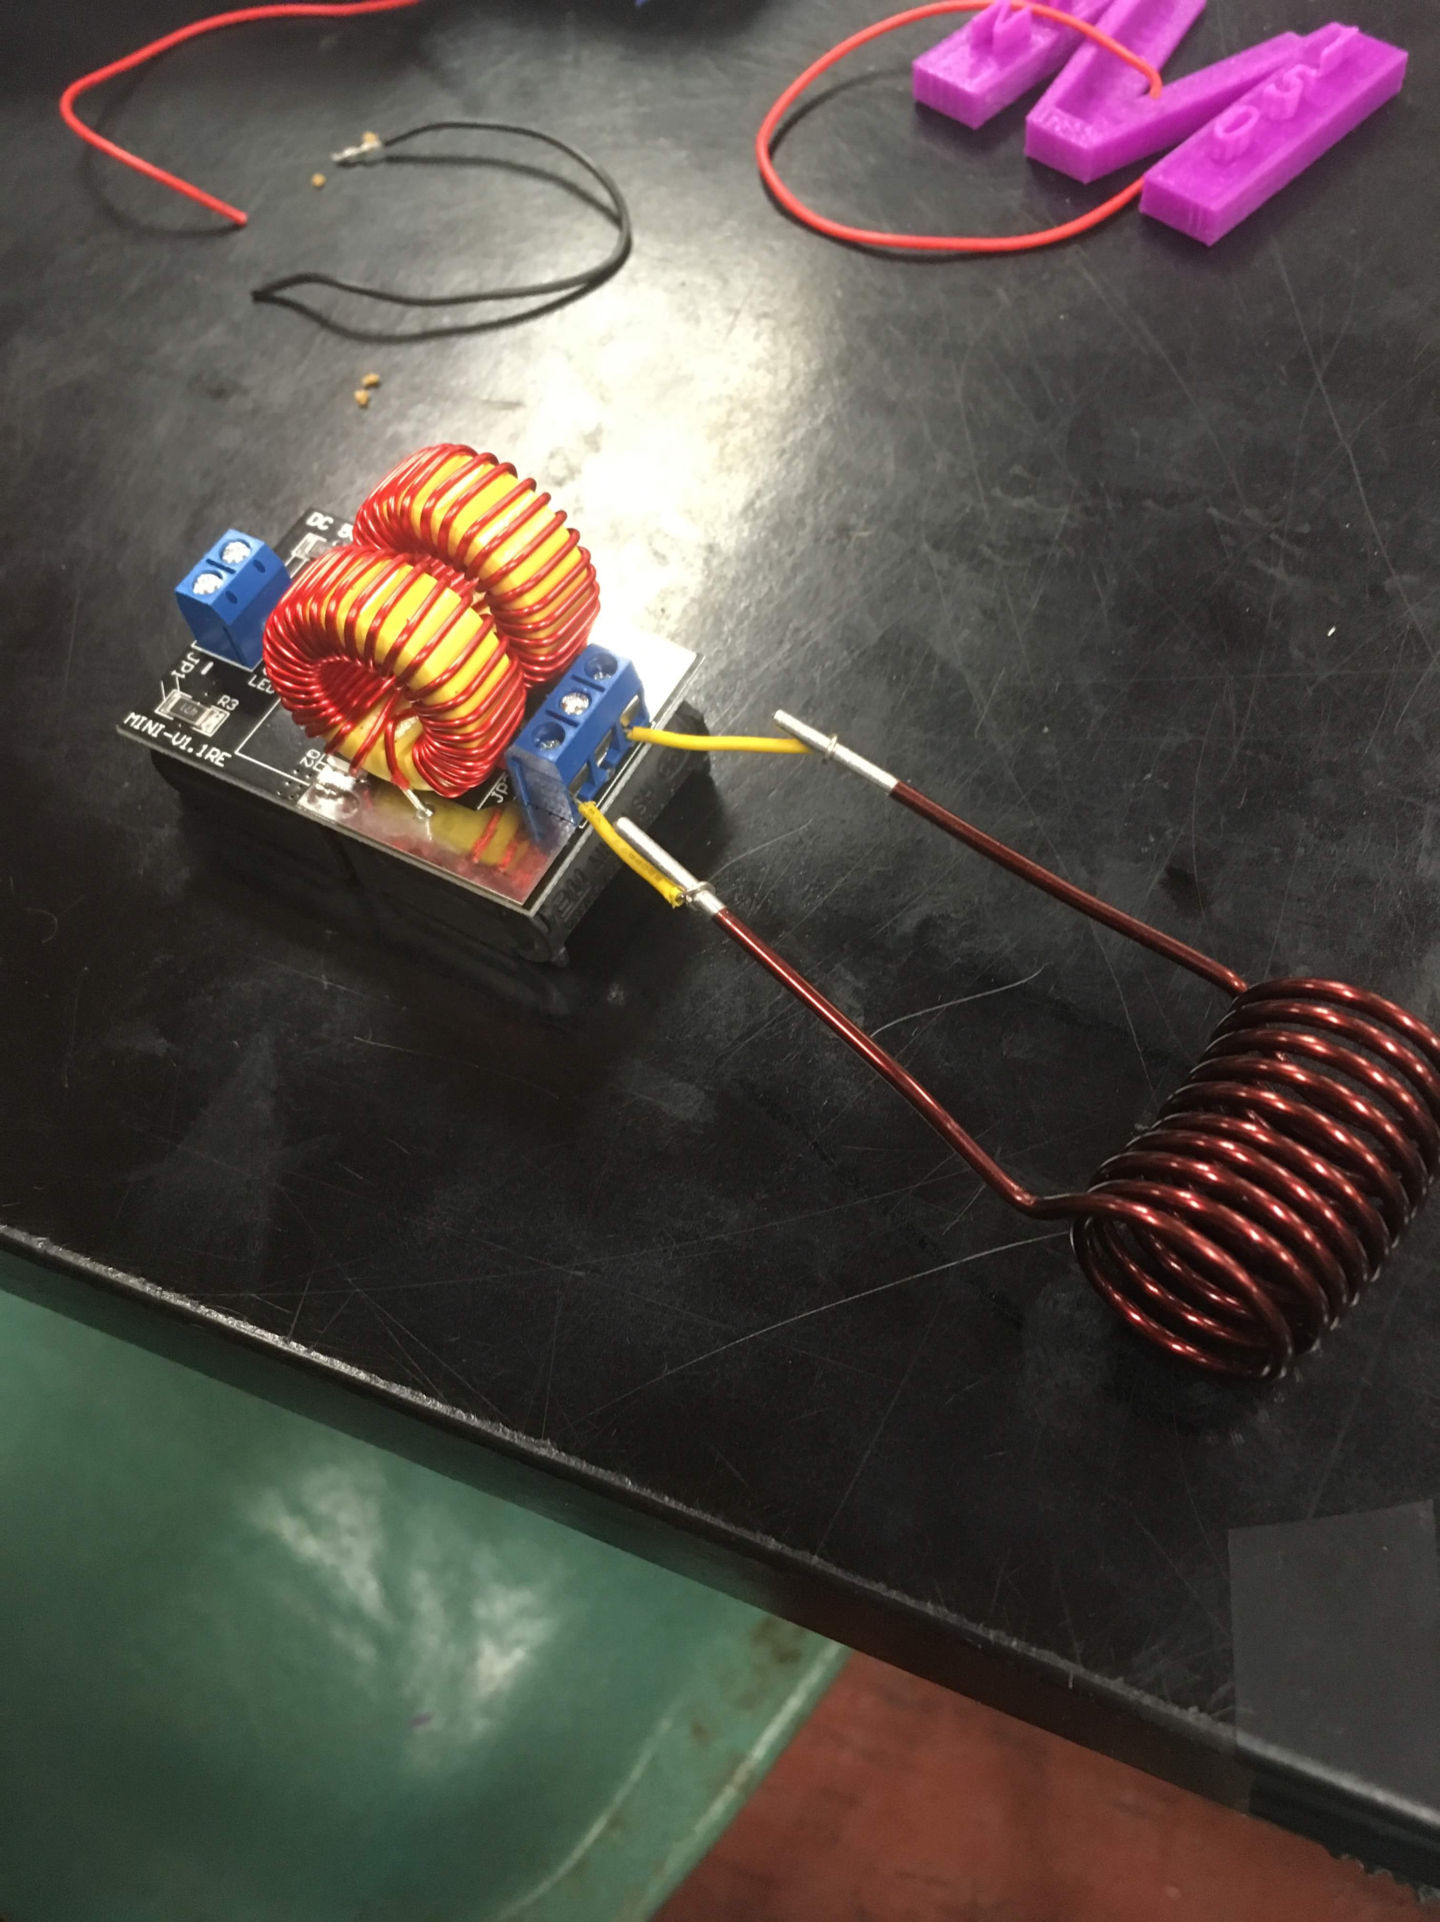
Heating Unit
Originally going to heat through current
Changed into induction heating
Added resistor to control heat
Problems with power control and consistency

Slide 4
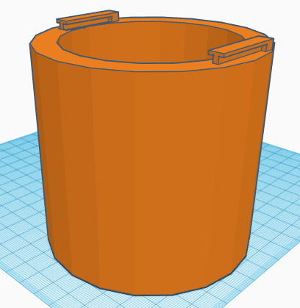
3D Design
Designed and tested joint unit
Used thread design for the two pieces
Printer wasn’t accurate enough to work
Redesigned a new sliding lock mechanism
Made small altercations before final print

Slide 5
Time Lapse of half of Sliding Lock Mechanism / Container

Slide 6
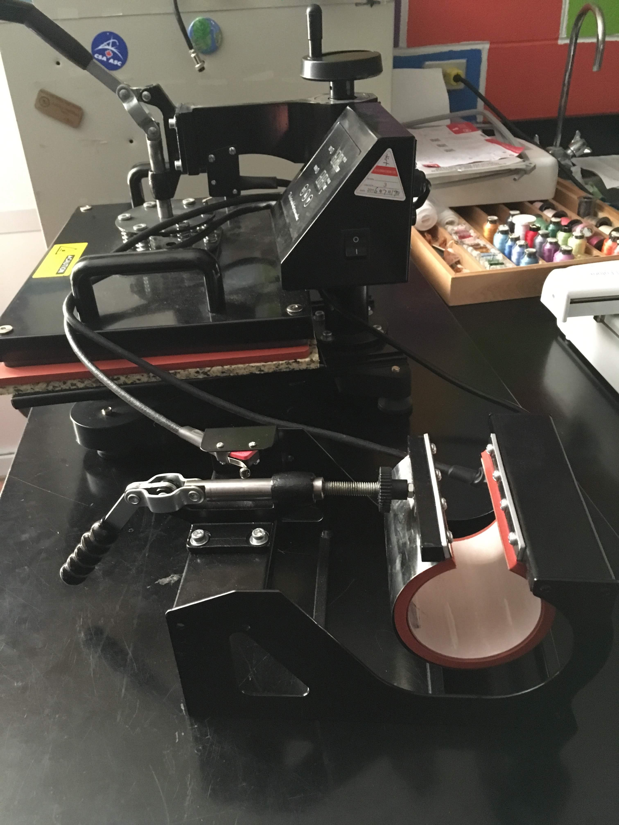
Heat Vinyl
Printed school logo, team name, and our names in white vinyl
Designed and printed flame pattern for school logos and team name

Slide 7
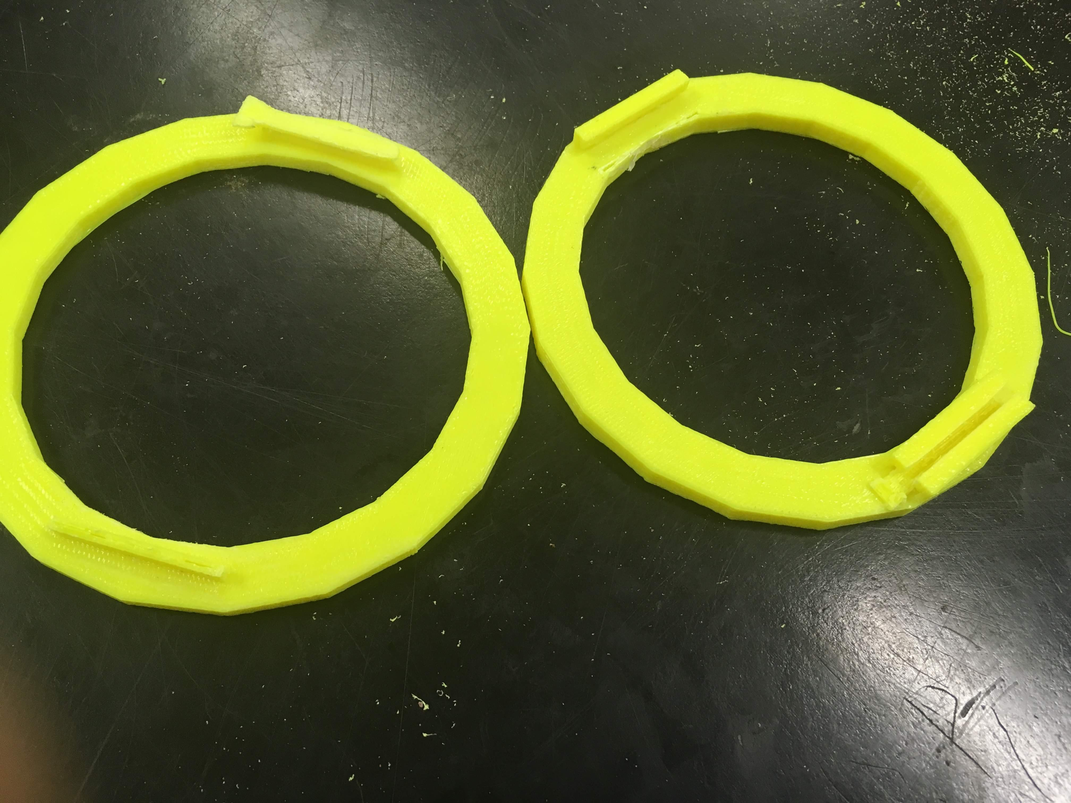
Aftermath
Designed and applied decals to bottle
Designed and printed base for heating unit
Made basic heating unit

