Slide 1
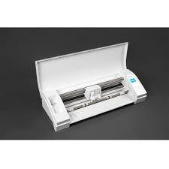
Vinyl Cutting 2017
By: Liam Richardson and Denver Dunfield

Slide 2
Introduction
At the beginning of the semester Denver was the only one working on vinyl cutting. I was able to join him. That being said he knew what he was doing, I didn’t. So Denver really took the lead with making the signs and stickers. I helped peel and get the vinyl on the cutting mat. At the beginning we definitely had some very unproductive classes but we got everything that was needed to be done finished.

Slide 3
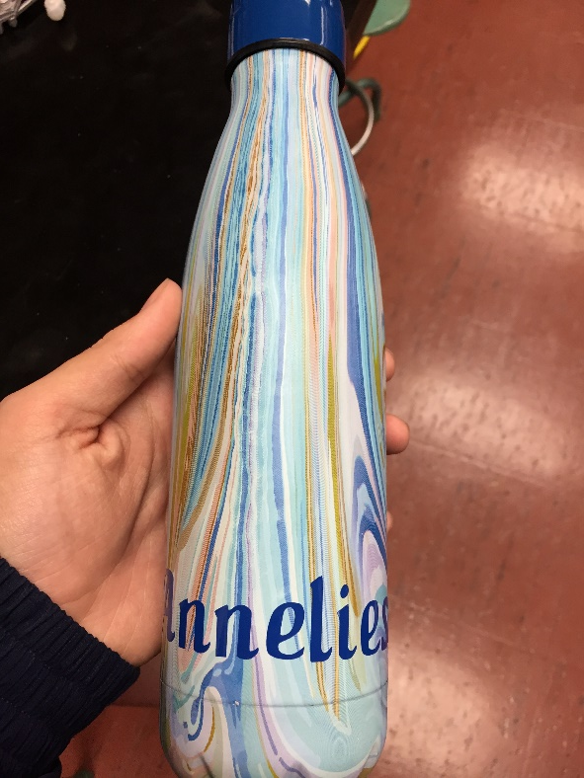
Water Bottles
Making custom stickers for bottles
Making gifts

Slide 4
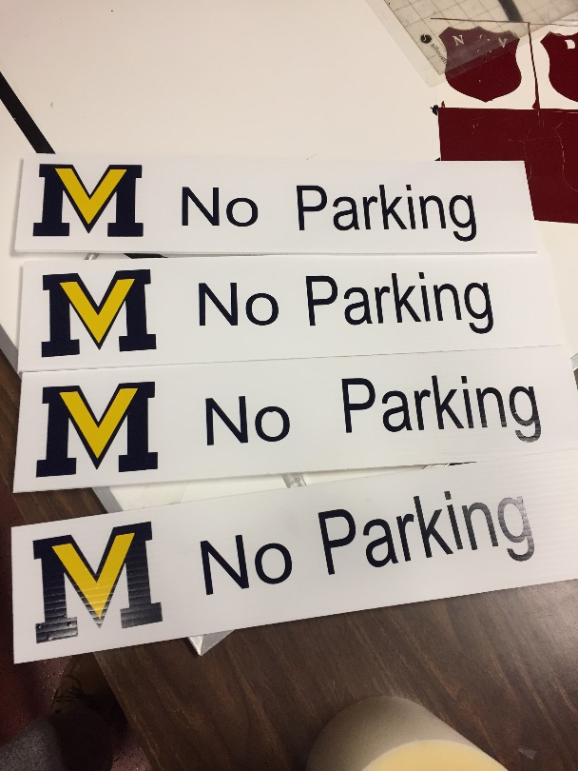
Signs
Started off making signs for Resource
Did a few demo signs
Was approached by the shop to make signs for them

Slide 5
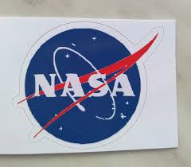
Stickers
Made stickers for cars
Also made stickers for cups
Stickers for windows
Stickers for phone cases

Slide 6
Summary
To summarize our project we complete 4 different jobs this part of he semester. We got 2 different signs made for the automotive shop. 2 water bottles made for Mrs Kelly and Mrs Mac. A gift made for the mother of Mrs Simpson. Last but not least little stickers for our phone cases (they didn’t last).
This was a great class, for tech points I’ll promote this class to the school.

