Slide 1
What’s Happening to Our Atlantic Salmon Population?
Presented by Hannah and Camryn

Slide 2
Some Big Issues…
The Striped Bass Theory.
Climate Change.
Water Pollution

Slide 3
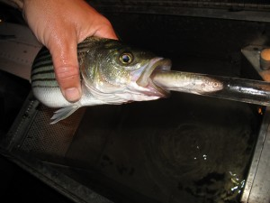
The Striped Bass Theory
Since the bass population is rising and the salmon population is declining some believe they are eating the salmon.

Slide 4
The Climate Change Theory
As water temperatures rise, the more effect it has on our Atlantic Salmon. Some issues include increased stress, depletion of energy, and increased chances of disease.

Slide 5
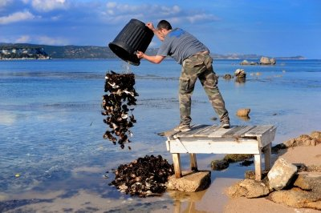
Water Pollution
With all the garbage people are throwing in our waters the more the salmon are eating and eventually dying. Some even get stuck in plastic as a smolt and grow around the garbage.

Slide 6
https://www.youtube.com/watch?v=0pvqUMqDQf0

Slide 7
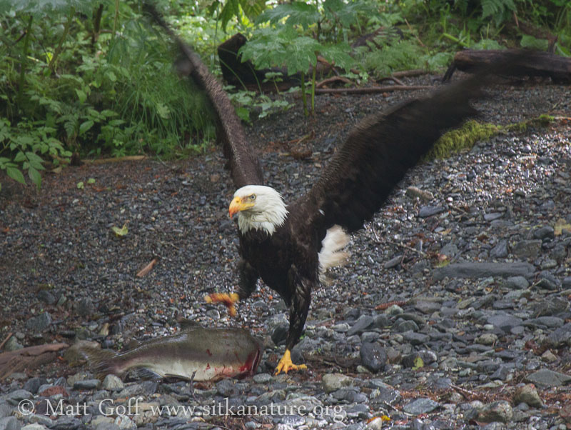
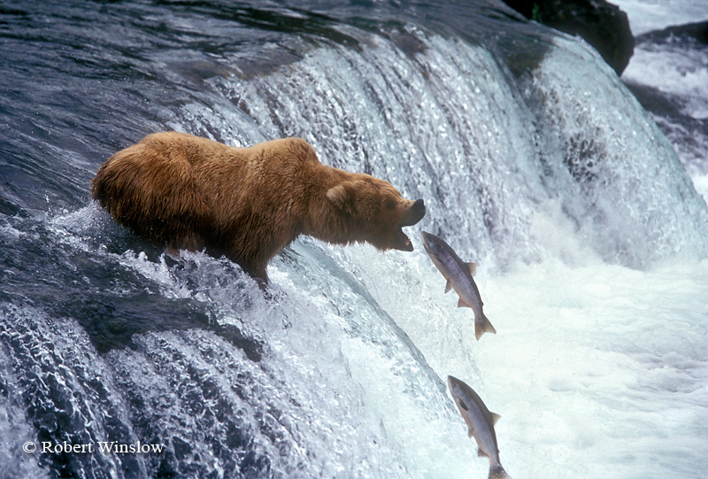
Without Atlantic Salmon other species will be hurt as well as they are a key member in many food chains. Some species that feed on the salmon include bears and eagles.

Slide 8
Review!
What is one factor that’s hurting the salmon population?
What animals feed on salmon?
Bonus!
What can you do to help?

