Slide 1
Deforestation
by Jenica Gallan & Austin Hamilton

Slide 2
How many trees are cut down every year?
A study estimates that there are about 3.04 trillion trees on the planet, and about 15.3 billion trees are cut down every year, so about 46% of the trees on the planet are cut down in 12000 years.

Slide 3
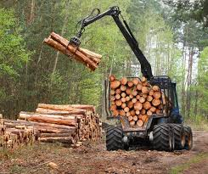
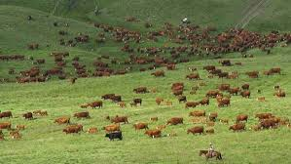
What causes deforestation?
new roads being built.
harvesting wood to make paper, furniture and homes.
urbanization, housings.
overpopulation.
livestock ranching.

Slide 4
Habitats being destroyed
The current rate of deforestation is 160,000 square kilometers per year, which equates to a loss of approximately 1% of the forest habitats every year.
Habitat destruction is currently the first cause of species extinction worldwide.

Slide 5
Tropical Rainforest deforestation
About half of the world's tropical forests have been cleared. And every minute about 36 football fields worth of trees are lost.
tropical rainforest are most likely to be targeted in deforestation.
tropical forests cover only about 7 percent of the Earth’s dry land, but they probably harbor about half of all species on Earth,and deforestation can cause the animals to become vulnerable for extinction.

Slide 6
short video
video.nationalgeographic.com/video/101-videos/climate-101-deforestation

Slide 7
climate change
Deforestation also drives climate change. Forest soils are moist, but without protection from sun-blocking tree cover, they quickly dry out.
Trees also help the water cycle by returning water up into to the atmosphere, without trees to fill these roles, many forest lands can quickly become deserts.
Trees also play a critical role in absorbing the greenhouse gases that fuel global warming. Less forests means larger amounts of greenhouse gases entering the atmosphere and a increasing speed of global warming.

Slide 8
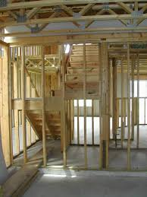
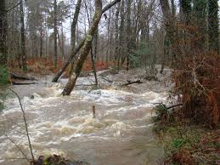
pros and cons of deforestation.
pro- more room to grow new trees, makes us material we need and gives us revenue.
cons- more carbon dioxide, flooding, wildlife being destroyed.

Slide 9
How to prevent deforestation.
plant a tree
go paperless
recycle and buy recycled products
go electrical, dont burn wood.
when shopping go towards buying recycled products.

