Slide 1
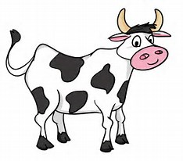
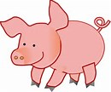
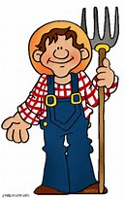
Factory farming
Why it’s bad.
By Kaitlynn flaherty

Slide 2
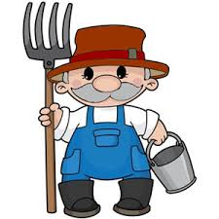
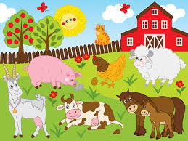
FACTS:
Factory farming is all around the world.
In factory farms there are many animals such as; pigs, chickens, goats, cows, and turkeys etc.…
Animals in factory farms aren’t treated good.

Slide 3
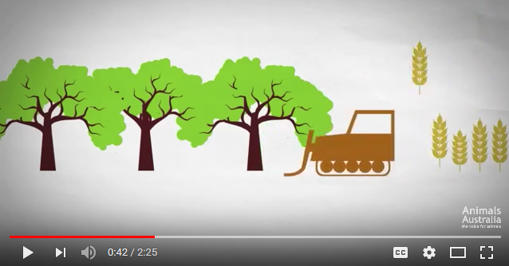
https://www.youtube.com/watch?v=7I0v3LhKhQg

Slide 4
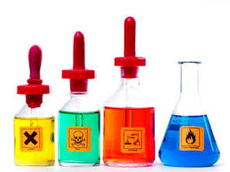
BAD FOR THE ENVIRONMENT?
Factory farms pollute the air with methane.
Methane has a higher affect that is twenty times higher than carbon dioxide.
There is ninety million tons of carbon dioxide being released into the air every year.
The gases the factory farm releases can cause health problems in humans due to the harmful gases.
Gases such as ammonia and hydrogen sulfide are in these gases and can cause death if breathed in a strong amount.

Slide 5
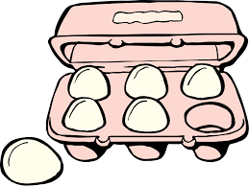
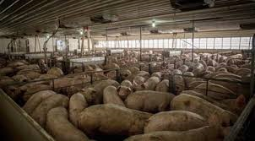
Expectations vs. Reality
Most people think of factory farming as a good thing.
They think there is nothing bad happening inside of the farm.
They think that it is the only way to produce “good” meat, eggs, chicken, etc…
In factory farms their can be hundreds to thousands of animals in a small space.
The so called “farmers” treat the animals with antibiotics to prevent disease because they are filled with disease due to being unsanitanized.
There are many germs inside the factory farms, the floors are covered in the animals feces and the smell is said to be “terrible”

Slide 6
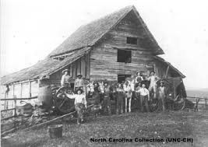
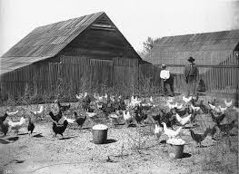
HISTORY OF FACTORY FARMING…
Factory farming started in the late 1900’s
In the older days the animals were kept in a fenced in area.
They had space outdoors and fresh air
The farmer would keep the space neat and tidy

Slide 7
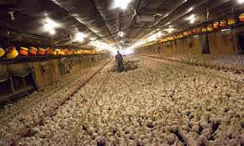
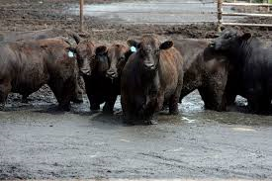
Today’s Factory Farming…
Due to land issues they decided to put the animals in an closed building
The farmers don’t treat the animals with respect or proper manners.
Farmers/workers abuse the animals,,, verbally, mentally and physically
They feed the animals guts of other animals most of the time.
The other times the animals are fed very little grain.

Slide 8
What do Factory farms do to the animals?
They mentally abuse the animals( playing mind games and separation. This can cause anxiety, depression and stress disorder.)
Verbally abusing the animals( The animals at factory farms are always being yelled at. This can cause hearing problems and stress.)
Physically abusing the animals( kicking, punching, or hitting the animal.)

Slide 9
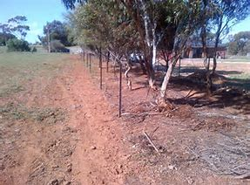
Why do we have factory farms?
Because of the amount of people in the world
People “need” their eggs, beef, chicken, etc.…
To not take up so much land( they don’t want the animals to run free because it takes up a lot more land.)

Slide 10
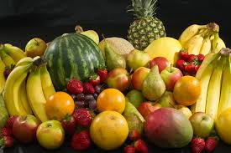
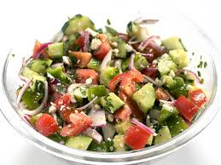
How can we reduce this problem?
Eating better
Know where your food comes from
Vote out the “big” factory farms

Slide 11
TRIVIA
How many tons of carbon dioxide are released into the air every air? 90 million tons
When did factory farming start to coming into business? The late 1900’s
Name 3 animals that could be in factory farms cows, chickens, and pigs
Name one reason why we have factory farms the amount of people in the world
Name one thing about what they do to the animals in factory farms abuse them(physically, mentally etc..)

